Slide 1
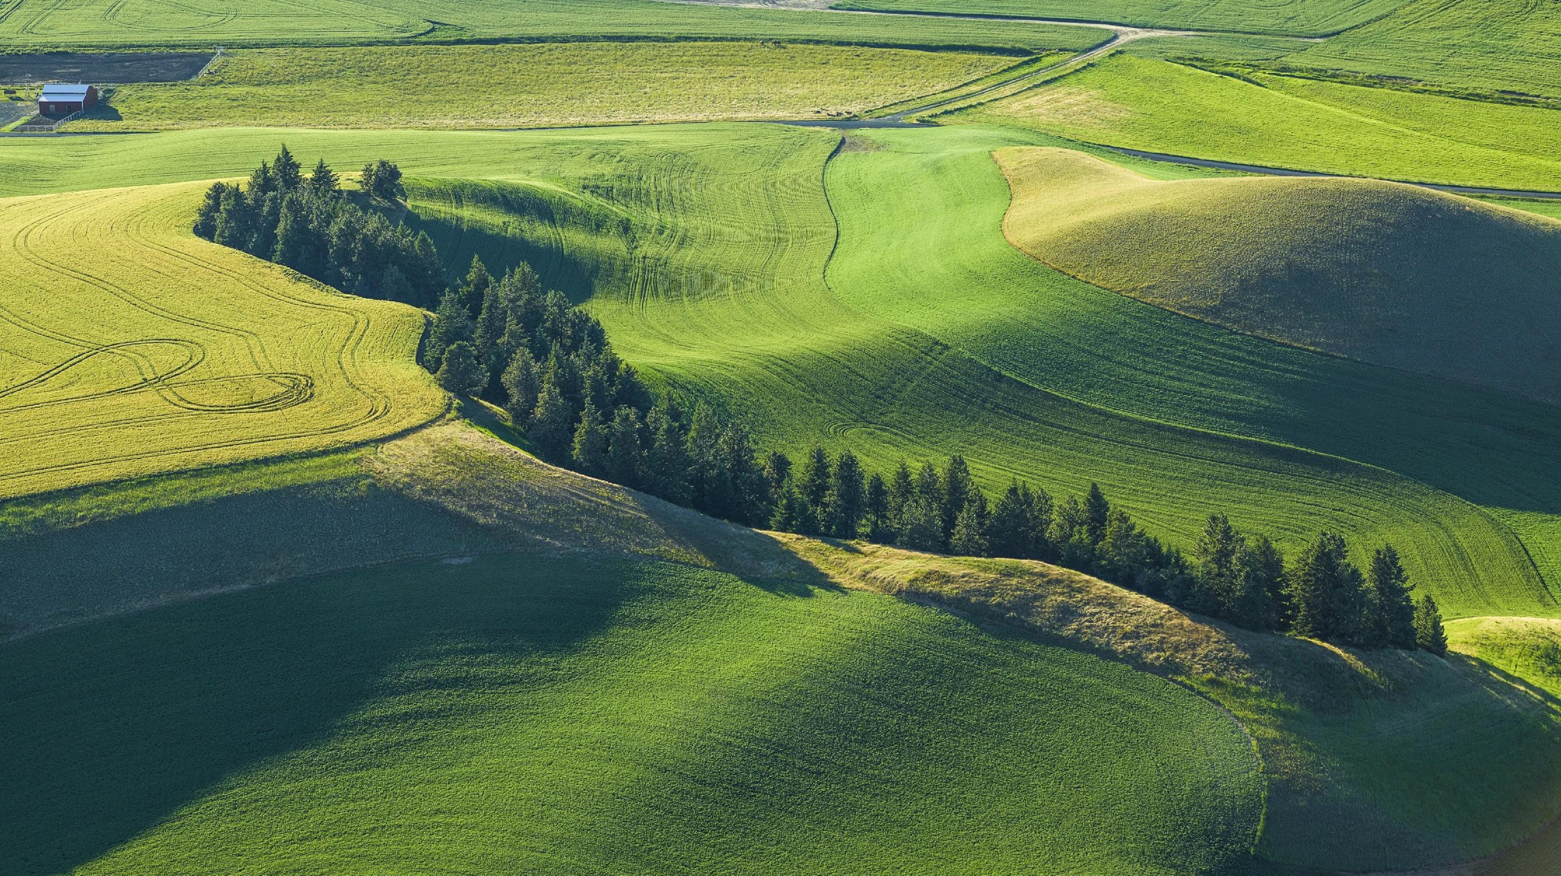
CONSERVATION & AGRICULTURAL
EASEMENTS

Slide 2
THE CHALLENGE
25%
64%
60
81%
Oregon land in farms & ranches
will change hands in 20 years
average age of farmers & ranchers
of farmers & ranchers have no succession plan
Notes:
25% of Oregon is in farming and ranching
But 64% of it will change hands in 20 years
Because the average age of farmer/rancher is 60
Yet land is less affordable to the next generation - see slide 4 in Succession ppt.
What will happen to it is unknown, since it’s estimated that 81% of farmers/ranchers don’t have succession plans
From 2010-2016, only 41% of farm buyers in Oregon were farmers

Slide 3
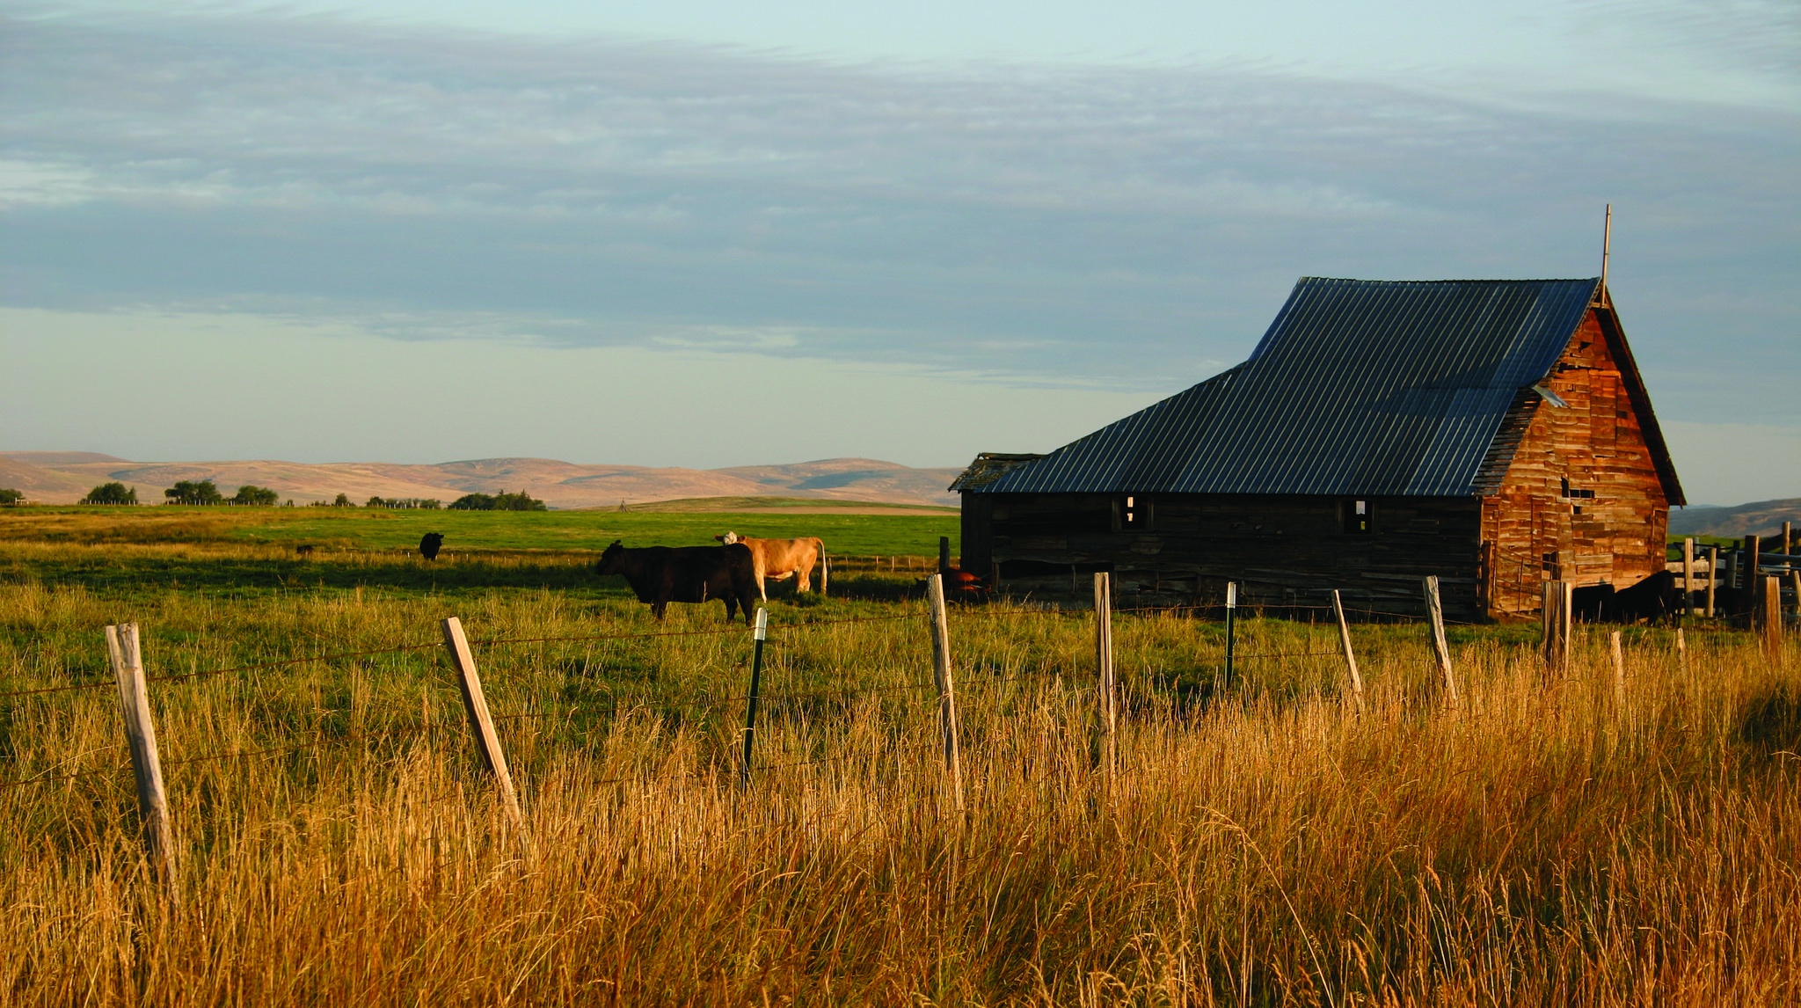
SUCCESSION
No Succession Plan May Cause Fragmentation or Consolidation
Parcels sold to pay fees & taxes
Converted to non-farm uses
Harder for beginning farmers
Notes:
Farmers and their family will often sell land to split up the assets and pay taxes
We have a great land use system in Oregon, but it’s not bullet-proof
Half a million acres taken out of production since 1974,
64,000 taken out of EFU zoning.
Death by 1,000 cuts due to parcelization and non-farm uses
Shadow development - land becomes less viable from planners’ perspective, and more likely to be zoned for development in the future.
Fragmentation different in different parts of state – 160 or 320 acres in E OR
BFR - Parcels are harder to make a living on, and it’s hard to buy into consolidated land

Slide 4
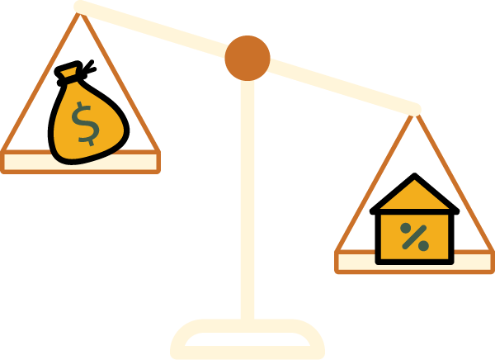
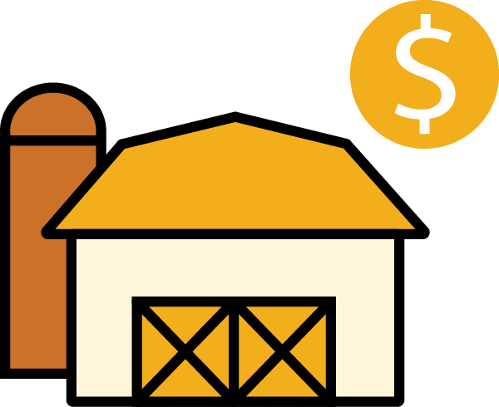
LAND ACCESS
Beginning Farmers/Ranchers
Face Challenges Accessing Land
Competition from Amenity & Investment Buyers
Increasing Land Prices
Difficulty Cash Flowing a Mortgage
Notes:
In 2021, Oregon farmland real estate values grew 10.3% year-over-year – the only West Coast state to experience double-digit growth.
But rental rates are lower than WA and ID, in part because of land use ($179/acre vs. $197 in ID and $238 in WA)

Slide 5
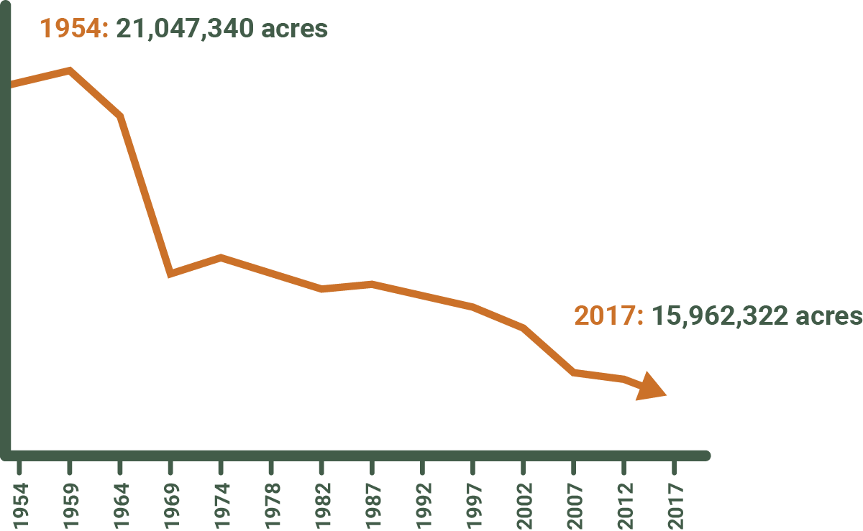
LAND USE
Oregon Ag Land Loss 1954–2017
Since the land use program was implemented in 1974, Oregon has lost more than 2.25 million acres from agricultural production.
Notes:
But we still have lost half a million acres of ag land to development since the program was established in 1973
Much of that is our most productive soils, which lie along waterways like the Willamette which is also where humans tend to settle.
And the number of exceptions to Exclusive Farm Use has grown by an average of one per year from 6 to over 60.
Groups like 1000 Friends of Oregon and their affiliates advocate to support Oregon’s land use program.

Slide 6
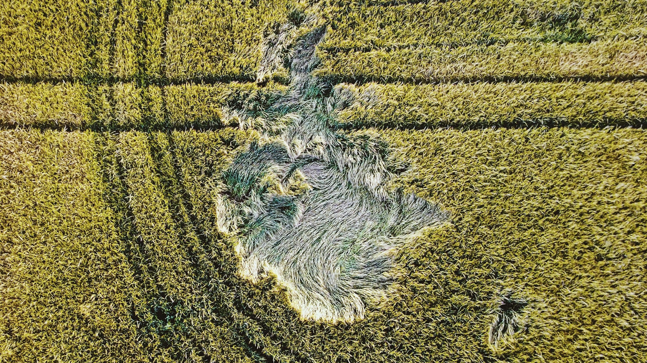
OREGON AGRICULTURAL TRUST

Slide 7
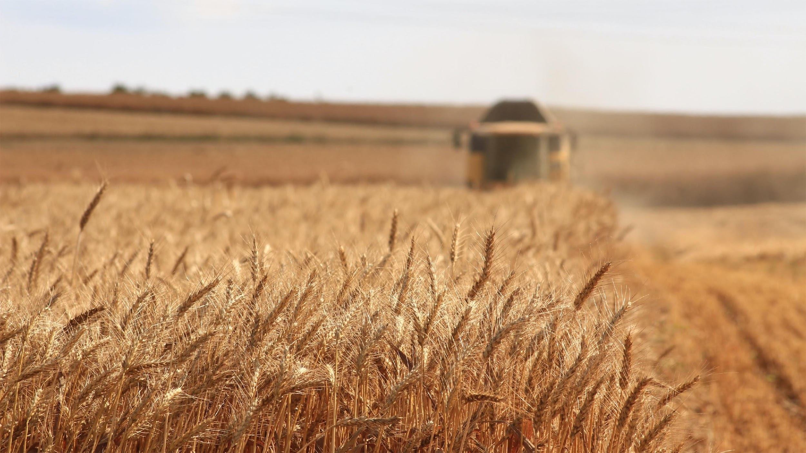
OREGON AGRICULTURAL TRUST
Our Mission
We partner with farmers and ranchers to protect agricultural lands for the benefit of Oregon’s economy, communities, and landscapes.

Slide 8
OREGON AGRICULTURAL TRUST
What We Do
AG LAND PROTECTION
TECHNICAL ASSISTANCE
Our primary tool is a working land easement — a voluntary agreement where the landowner sells or donates their development rights to keep their land available for agriculture forever.
In addition to holding working land easements, OAT helps other organizations do the same by providing education and assistance.
EDUCATION
ADVOCACY
We educate farmers and ranchers, attorneys and appraisers, the general public, and decision-makers about farmland loss, easements, and succession.
We advocate alongside state and national partners for funding to protect agricultural land.

Slide 9
OREGON AGRICULTURAL TRUST
Where We Work
1
1
North Coast
Clatsop, Columbia, Tillamook, Lincoln
Mid-Columbia
Hood River, Wasco, Sherman
Mid/South Willamette
Clackamas, Marion, Polk, Linn, Benton, Lane
Southeast Oregon
Malheur, Harney, Lake
2
2
3
3
4
4

Slide 10
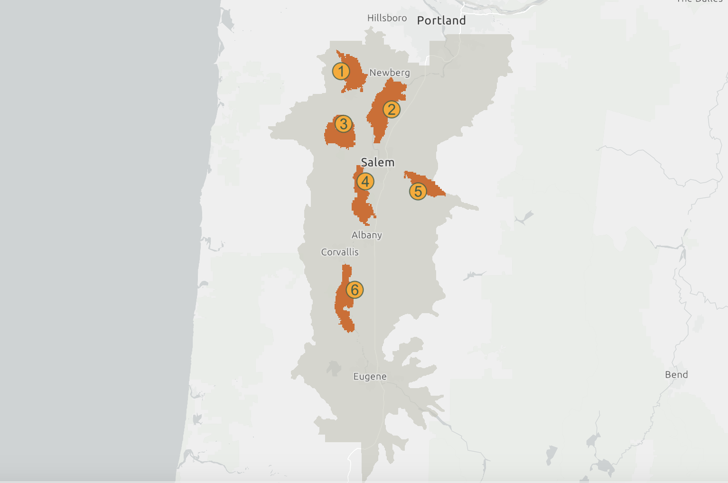
OREGON AGRICULTURAL TRUST
OREGON AGRICULTURAL TRUST

Slide 11
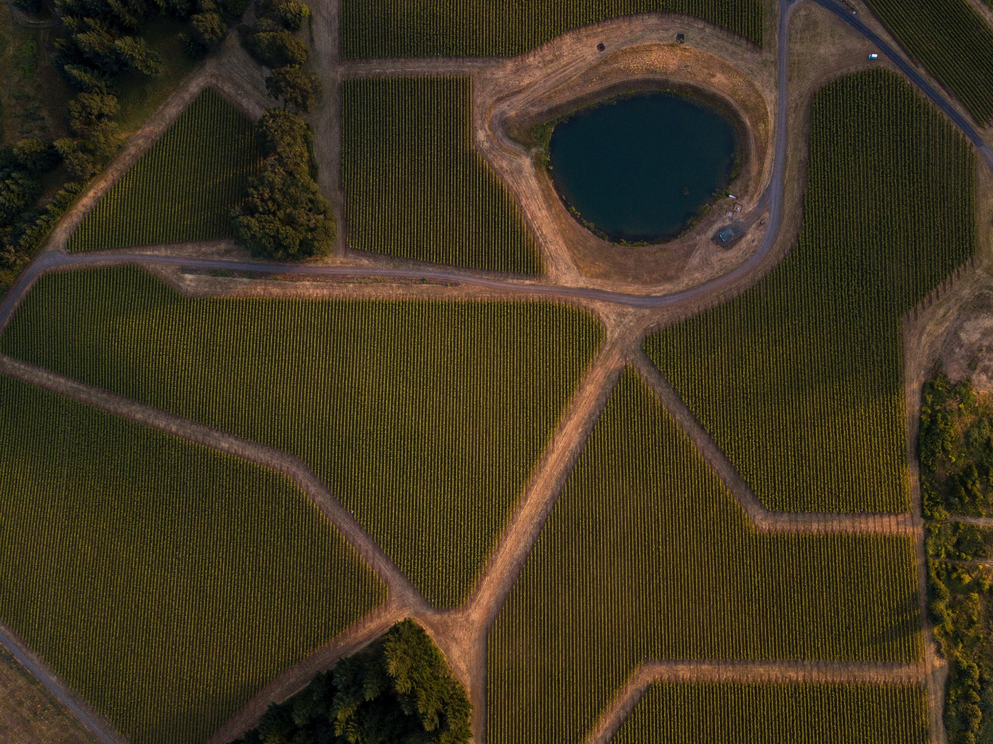
EASEMENTS 101
Notes:
Attorney, CPA, financial advisor, family counselor

Slide 12
EASEMENTS 101
What is a Conservation Easement?
A voluntary real estate contract
Between a landowner and a qualified easement holder
Permanently limits use of the land
To protect specific conservation values, including agriculture.
Disclaimer: This information is for education purposes only. It may not apply directly to your circumstances. For all conservation easement projects, OAT strongly recommends that landowners secure your own legal advice. We are not able to provide you with legal advice.
Notes:
Attorney, CPA, financial advisor, family counselor

Slide 13
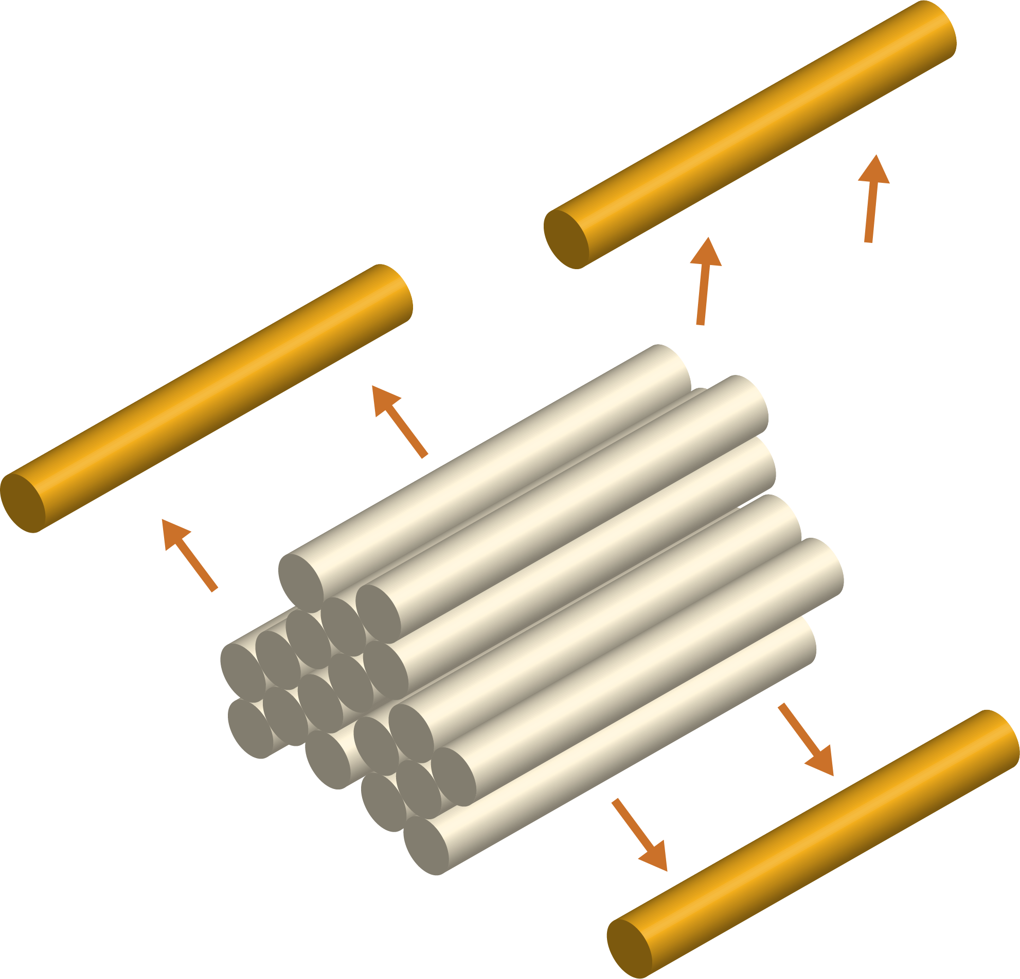
EASEMENTS 101
How Does a Conservation Easement Work?
Land ownership comes with many property rights
In a conservation easement, a landowner voluntarily sells or donates certain rights.
Surrendered Property Rights
Conservation Easement
Property Rights
Post-Easement Property Rights (including ownership & right to sell)
Notes:
For example, a landowner may restrict or limit the rights to develop a property for commercial, industrial, or multi-residential purposes while retaining rights to use the land for grazing, farming, harvesting of timber, recreation, or for residences for the owner’s family. These rights you relinquish can be either sold or donated. The landowner still owns the property and retains the right to sell or lease the land and to pass it on to your heirs. Once sticks are removed, they cannot be put back.

Slide 14
EASEMENTS 101
Appraisal Valuation “Before & After” Analysis
— Both for purchases and donations
$1,000,000 value of property as is
- $700,000 value of property encumbered by easement
$300,000 value of conservation easement
$1,000,000
$300,000
EASEMENT VALUE
$700,000
$700,000
REMAINING PROPERTY VALUE
Value “as-is”
Value after easement
Total assets with easement
Notes:
Value is determined by calculating the difference between the value of the property today without (or “before”) the imposition of the easement and the value of the property today subject to (or after) the imposition of the easement. This latter value is determined by the nature of the restrictions and their impact on potential uses. The resulting amount is the value of the easement.

Slide 15
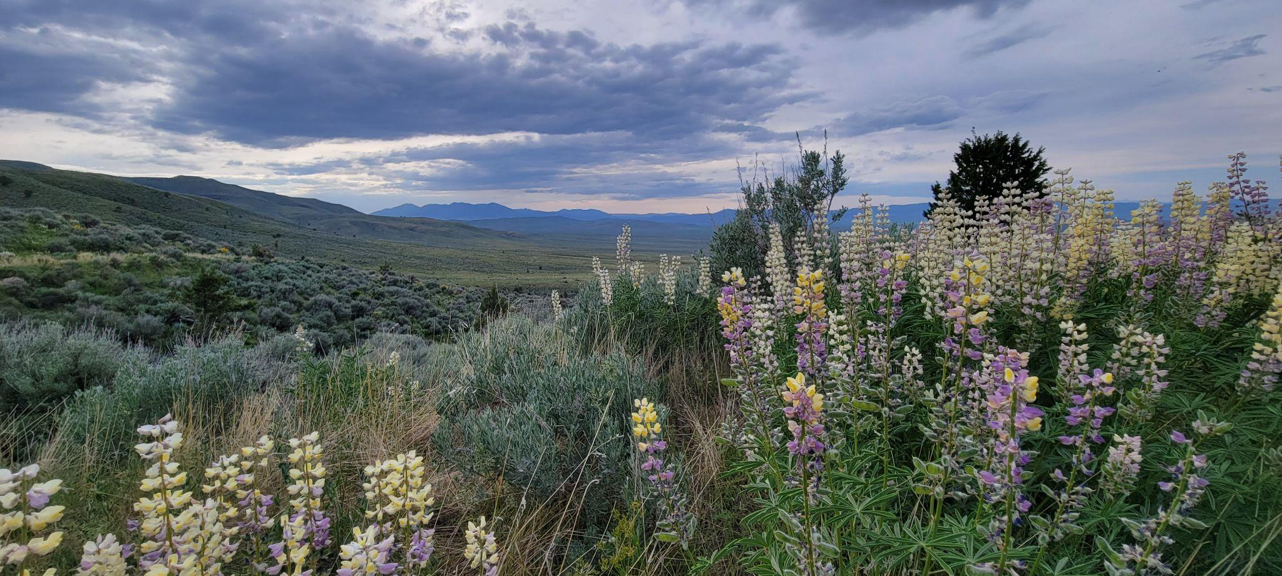
CONVEYING AN EASEMENT
Conservation easements…
Run with the land
Usually last in perpetuity
Are difficult to terminate
May be customized in size and include zones
Do not necessarily grant public access
Are more enduring than deed restrictions

Slide 16
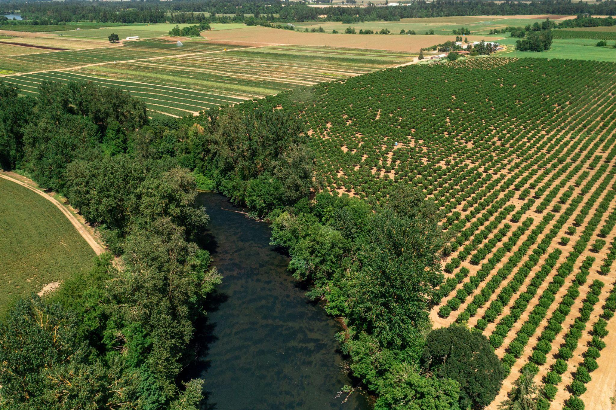
CONVEYING AN EASEMENT
Conservation easements…
May include restrictions that are not real estate property rights:
Prohibitions or requirements to use on certain types of production
Required conservation activities
Production agriculture provisions
Requirement to keep land in agricultural production
Option to Purchase at Agricultural Value
Right to forcibly lease

Slide 17
WHY CONVEY AN EASEMENT?
Notes:
Attorney, CPA, financial advisor, family counselor

Slide 18
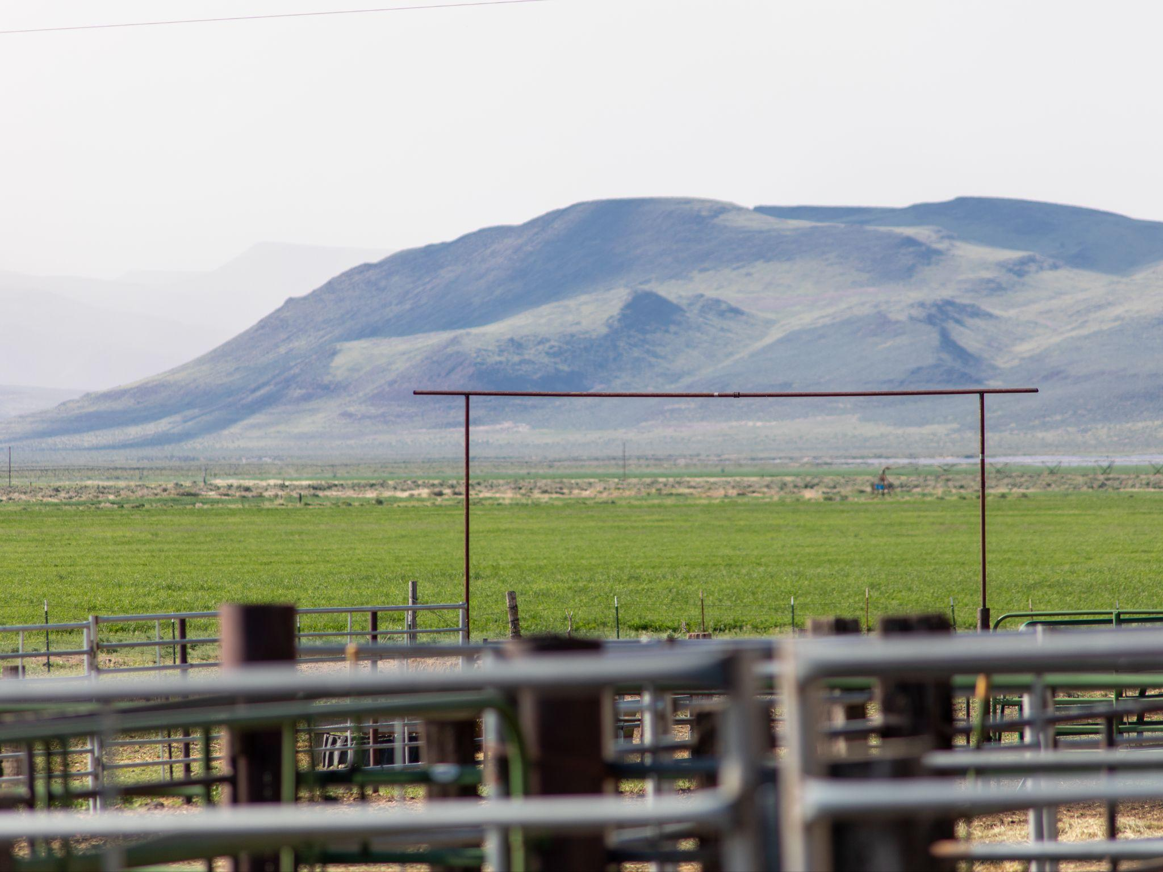
WHY CONVEY AN EASEMENT
Common Financial Benefits
Succession: Cash and/or Donation
Land affordability
Paying off a mortgage
1031 exchange
Charitable tax deduction

Slide 19
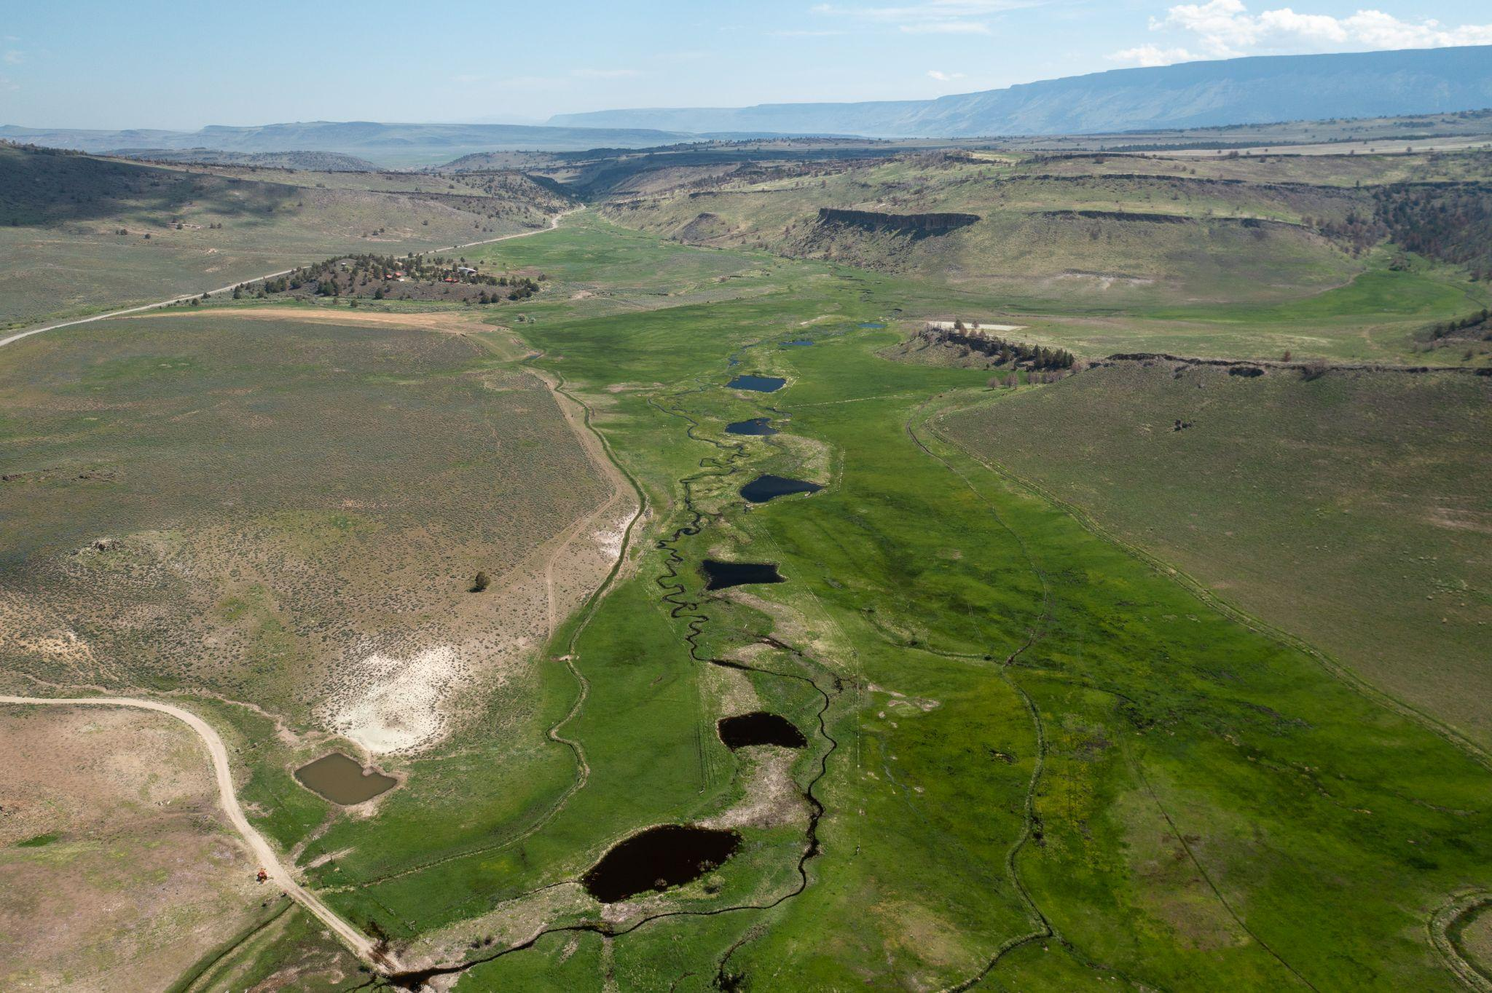
WHY CONVEY AN EASEMENT
Used for Succession
Reduce total estate value (consider Natural Resource Tax programs)
Federal income or estate tax deductions
Liquidity from real estate without selling
Divide decedent’s assets
Affordability for next buyers
Protect land from fragmentation

Slide 20
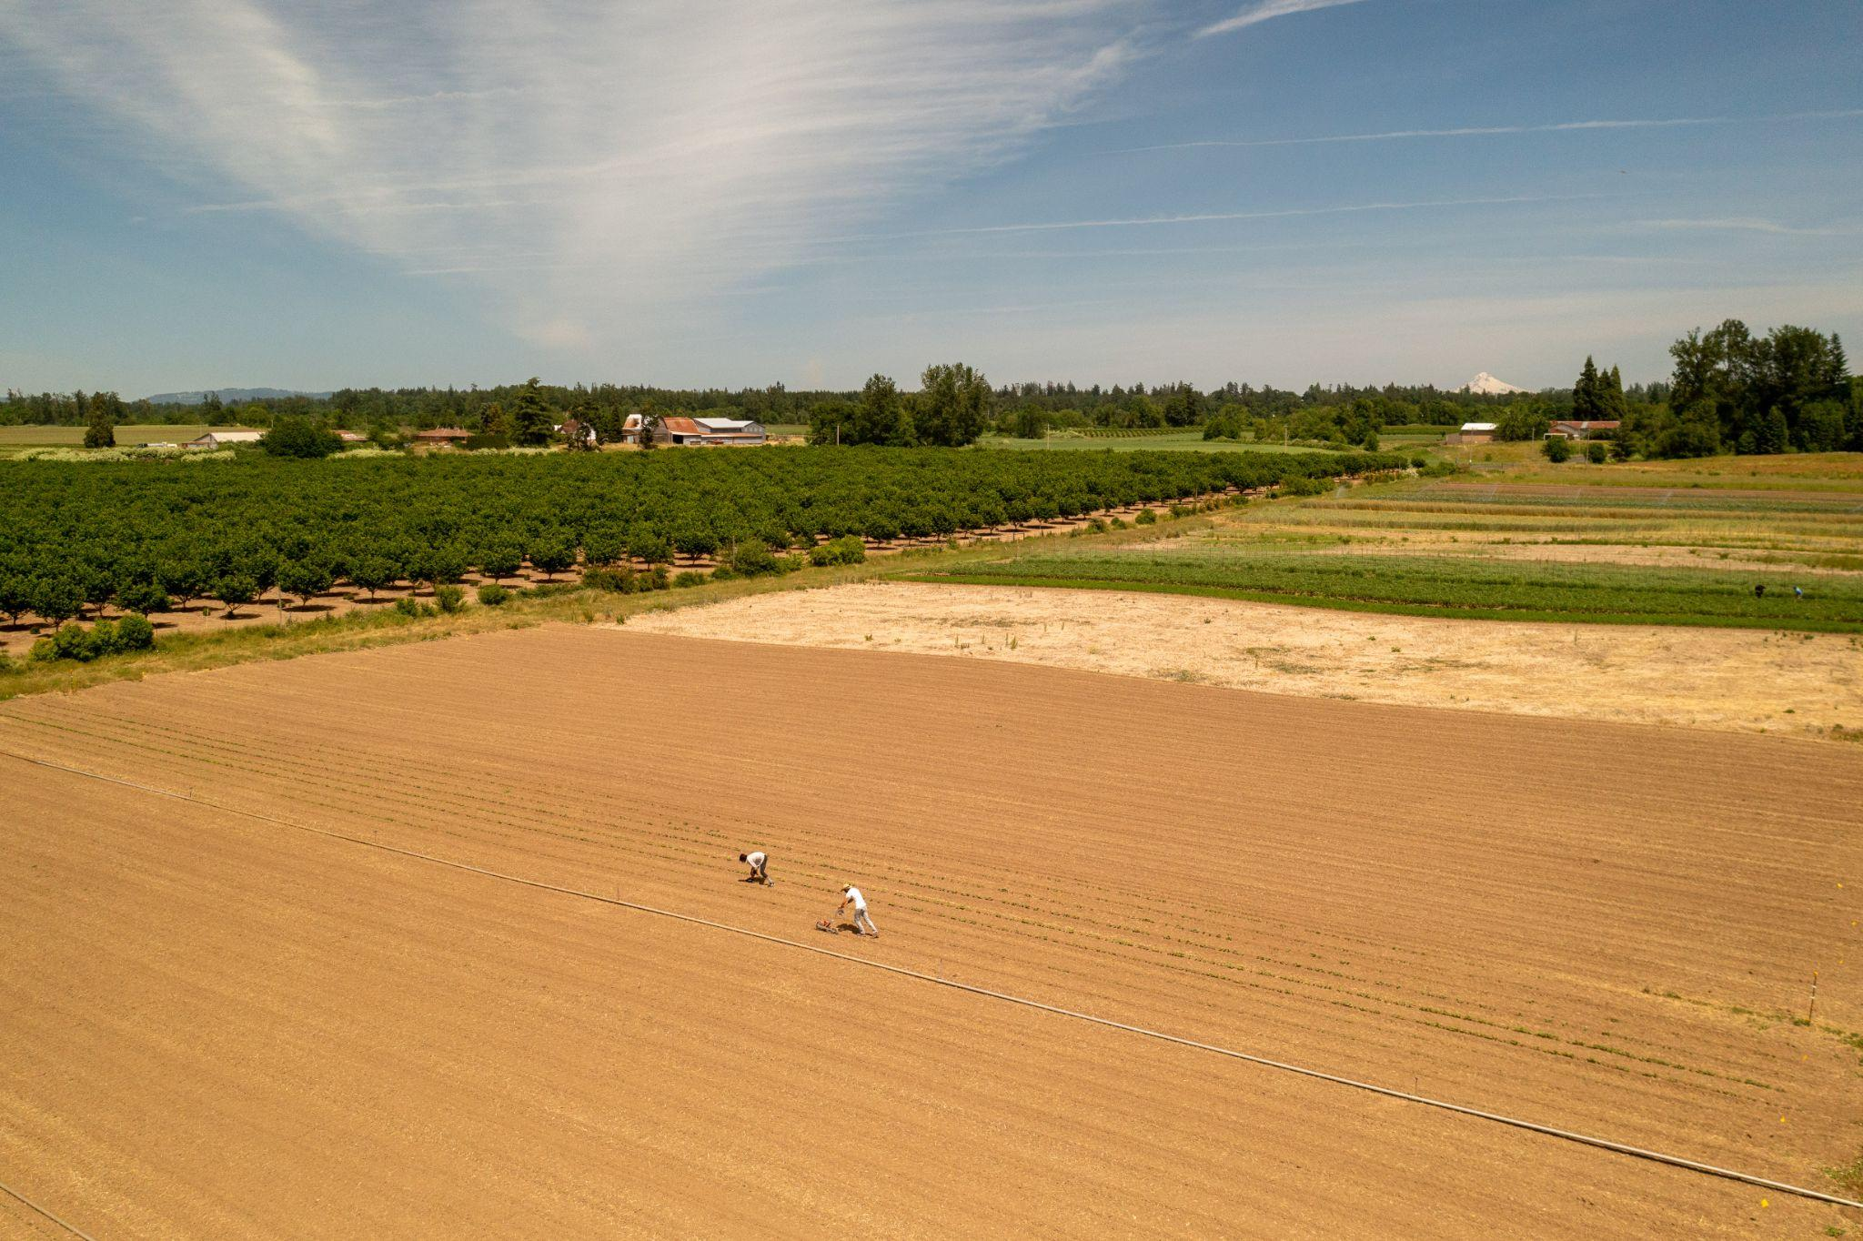
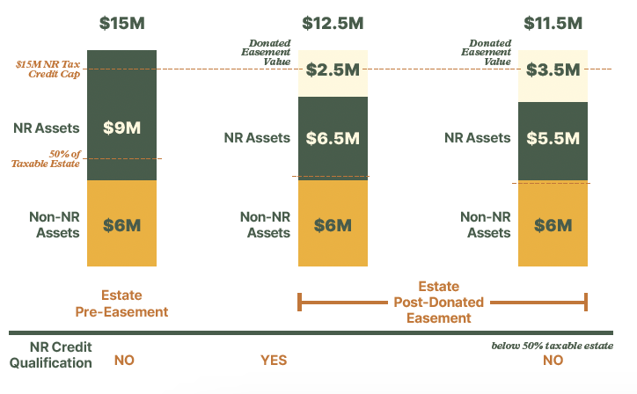
WHY CONVEY AN EASEMENT
Natural Resources Tax Credit

Slide 21
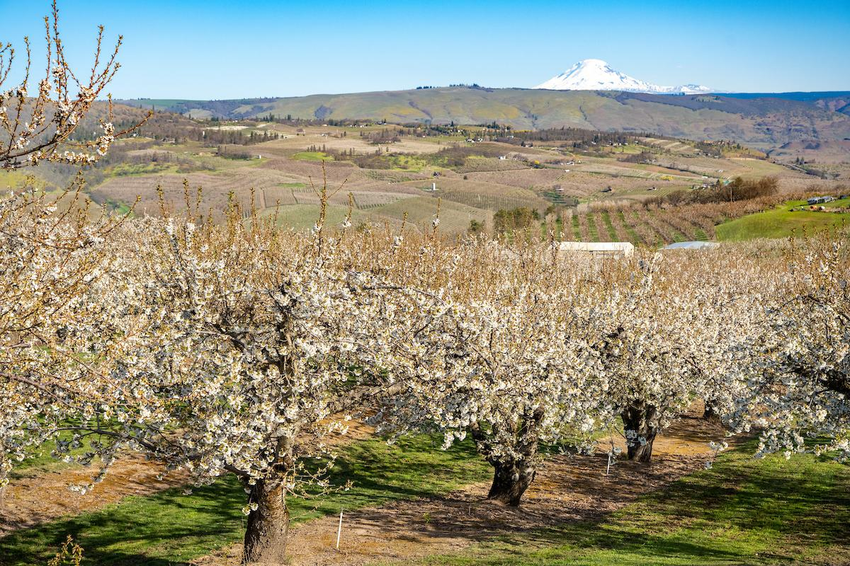
WHY CONVEY AN EASEMENT
Used for Land Affordability
For a Standard Property Purchase Transaction:
Landowner conveys easement to easement holder
Landowners and Buyers sign Purchase & Sale Agreement
Buyers sign a mortgage

Slide 22
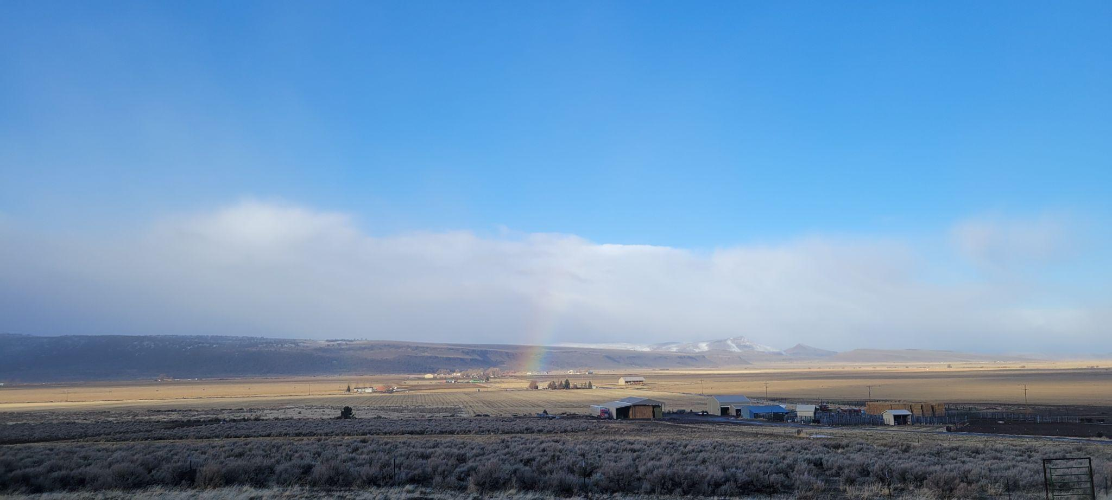
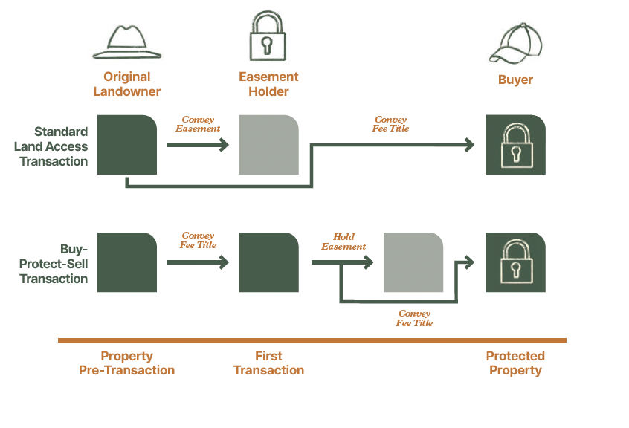
WHY CONVEY AN EASEMENT
Used for Land Affordability

Slide 23
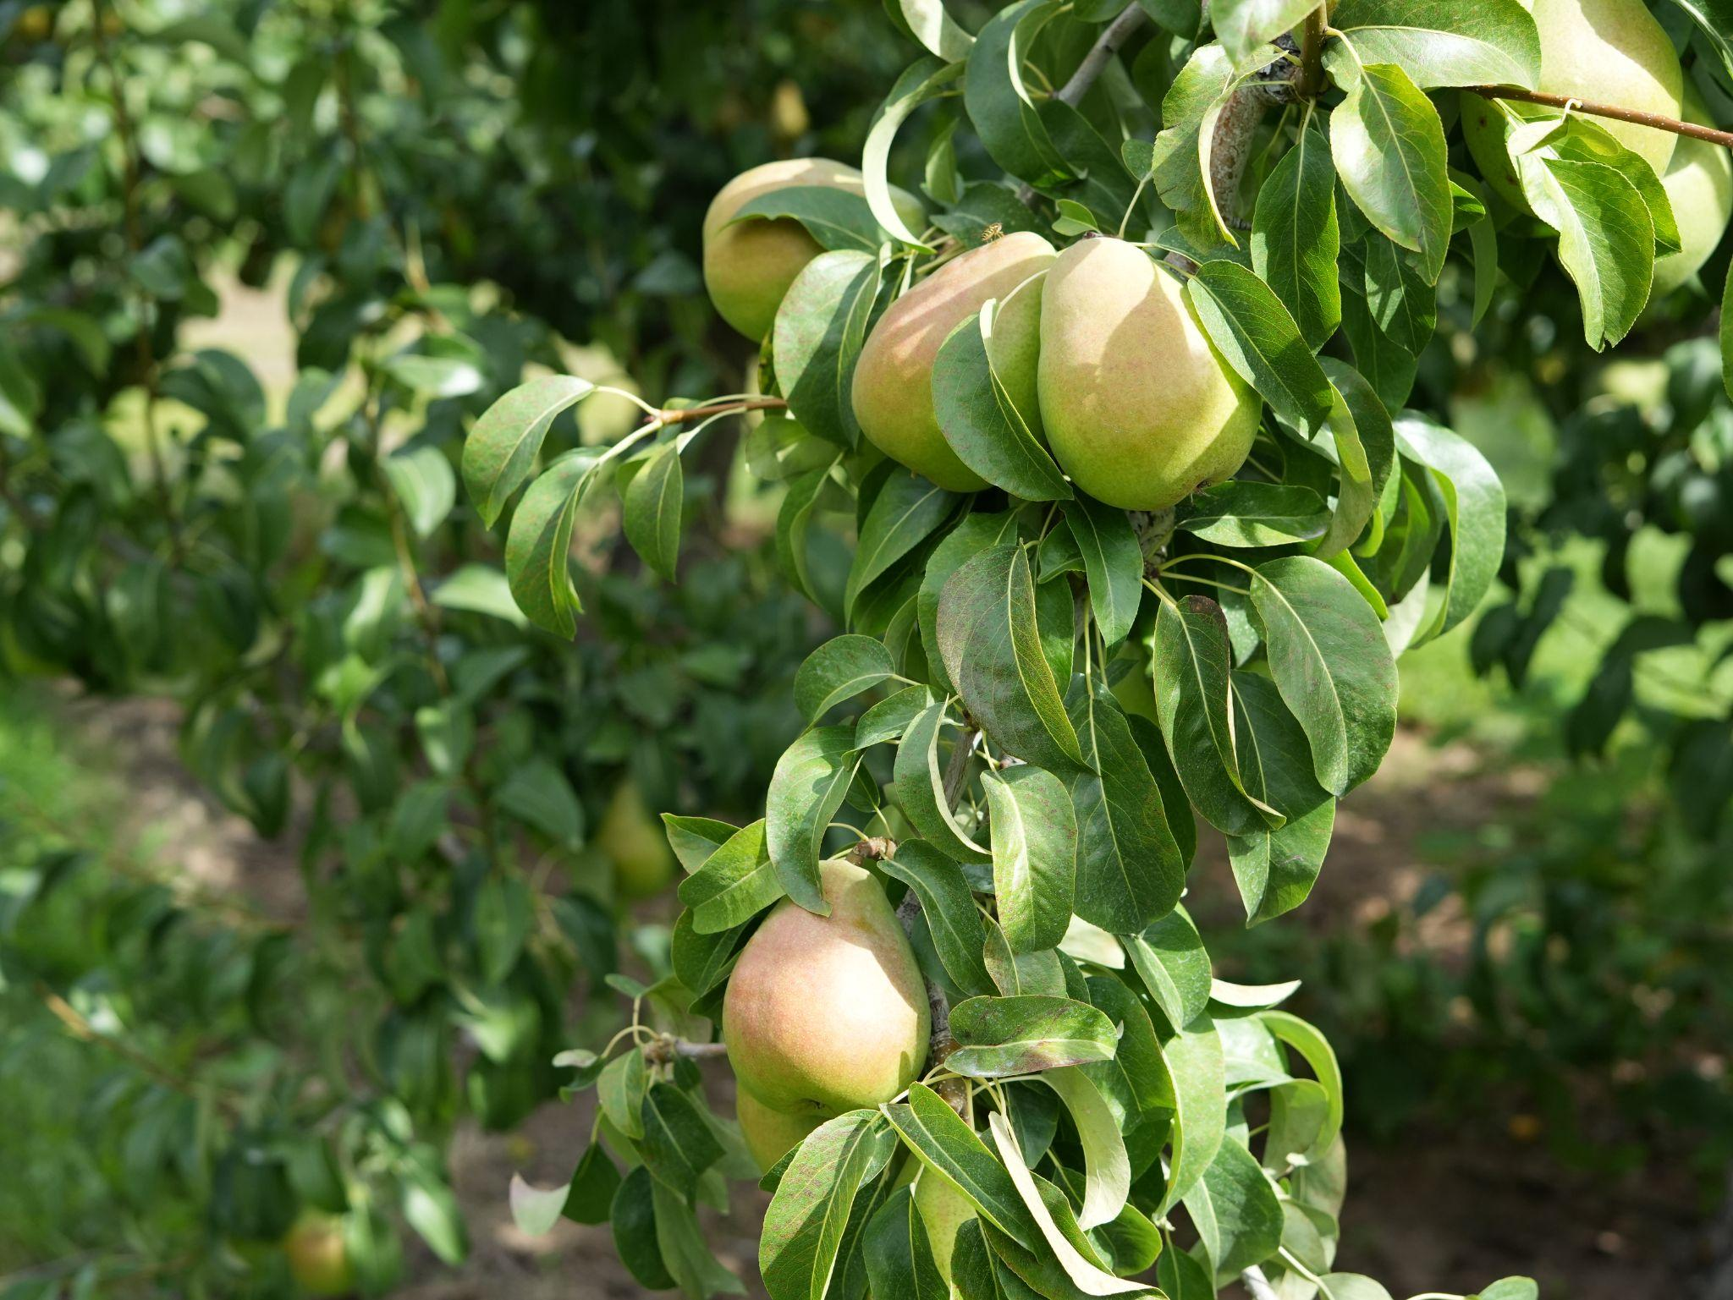
WHY CONVEY AN EASEMENT
Used to Pay Off a Mortgage
If landowner already owns the property
Capital gains tax is still due
Consider a mortgage interest deduction, if home included
Discuss with lender: Subordination, Pre-payment, Reamortization

Slide 24
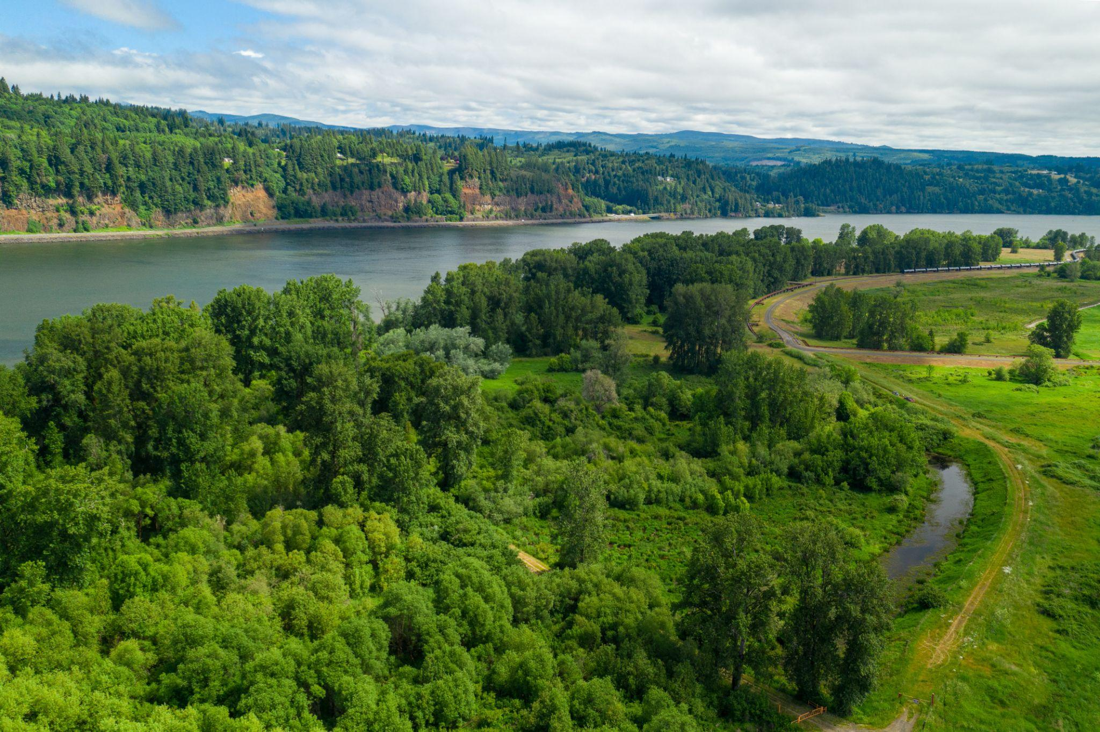
CONVEYING AN EASEMENT
Subordination
Required by IRS and most funders
Usually granted: easement holder will not request foreclosure proceeds
Lenders should determine if there will be sufficient collateral
Notes:
Once the easement is in place, the land trust works with the landowner to ensure that the easement continues to protect the conservation values. Most land trusts visit the property annually, but do not get involved in day to day land management activities. If the terms of the easement are violated and conservation values are threatened or damaged, the land trust must take action to enforce the easement.

Slide 25
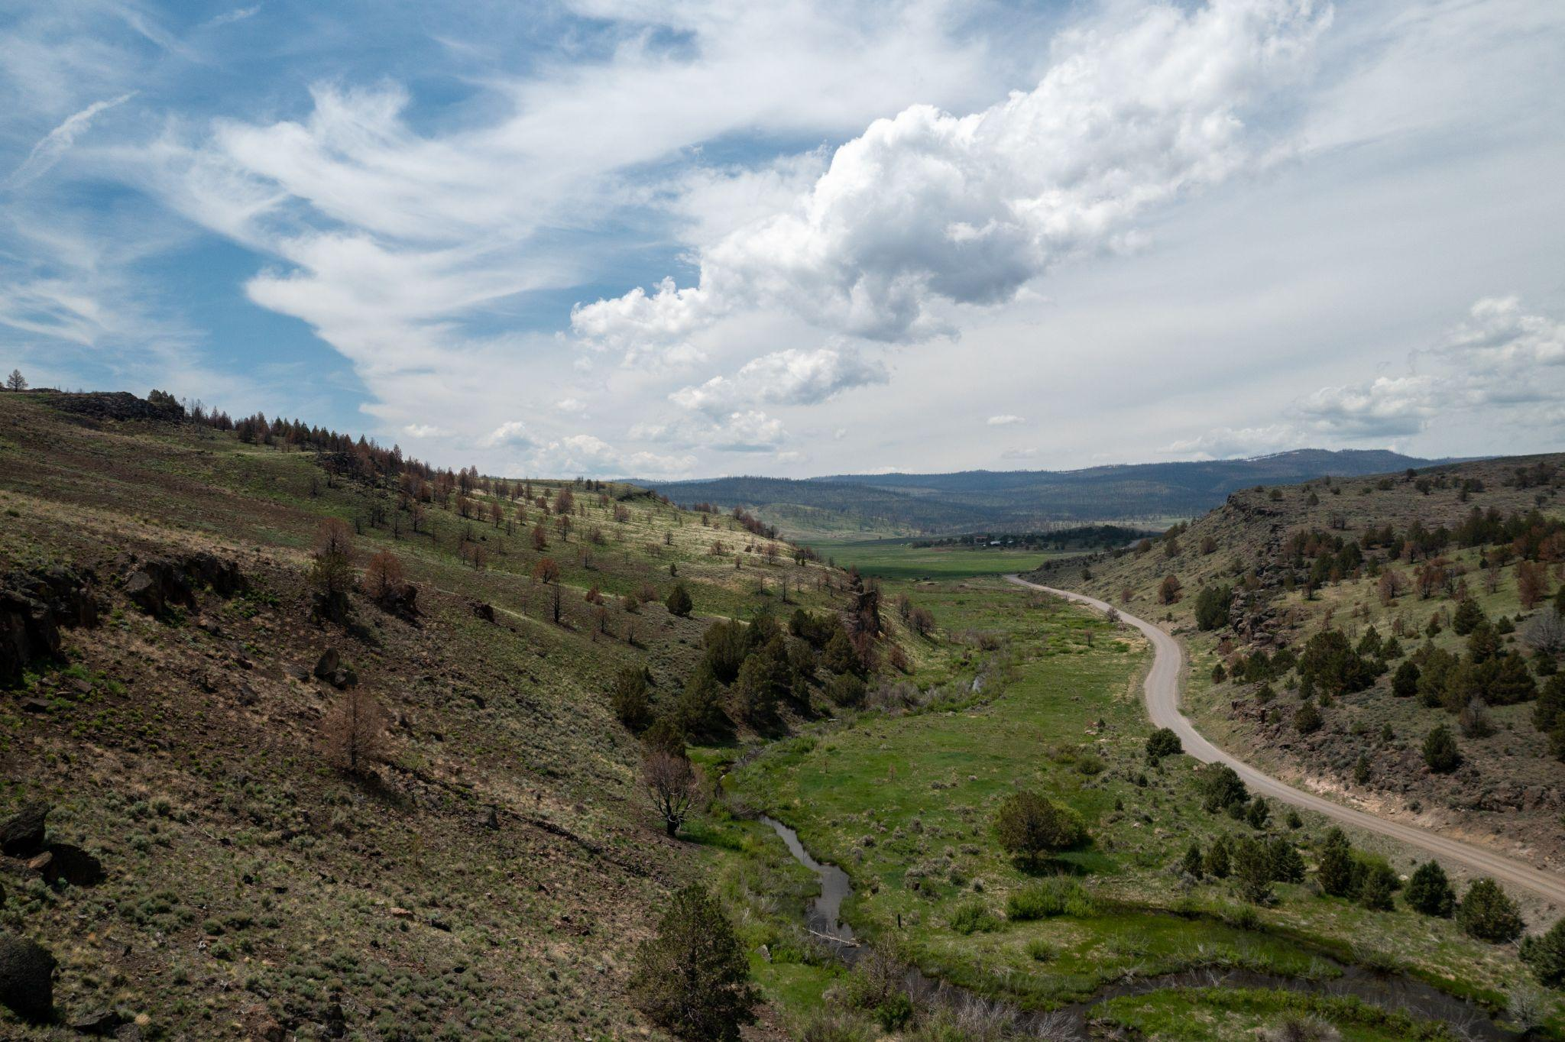
WHY CONVEY AN EASEMENT
1031 Exchange
Easement proceeds can be relinquished property
Replacement property must carry ≥ debt
Most difficult: 45-days to identify and 180-days to closing
If timing is an issue, consider:
PSA with extended closing
Reverse exchange (risky)
Gap title holder

Slide 26
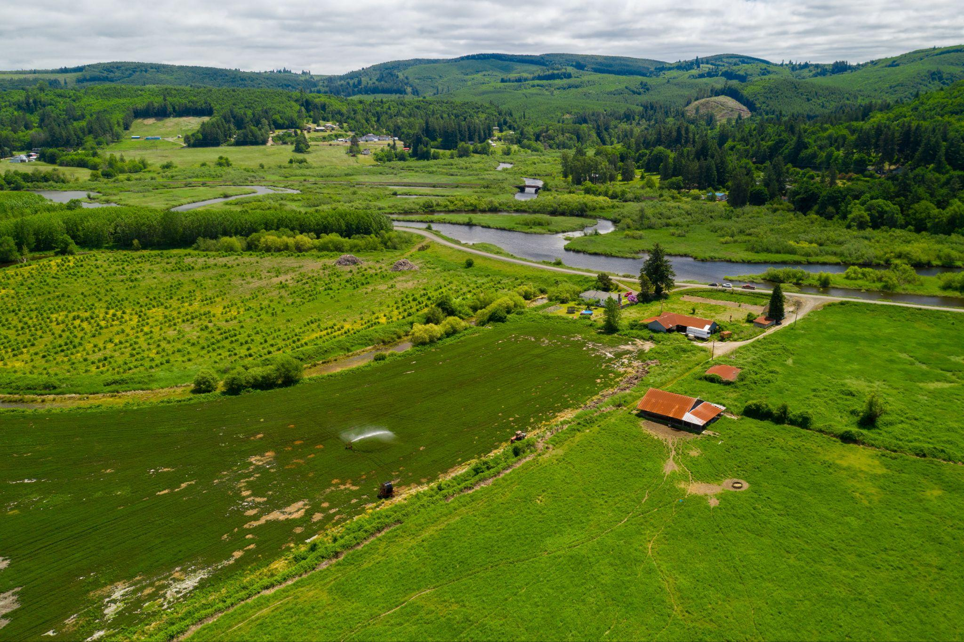
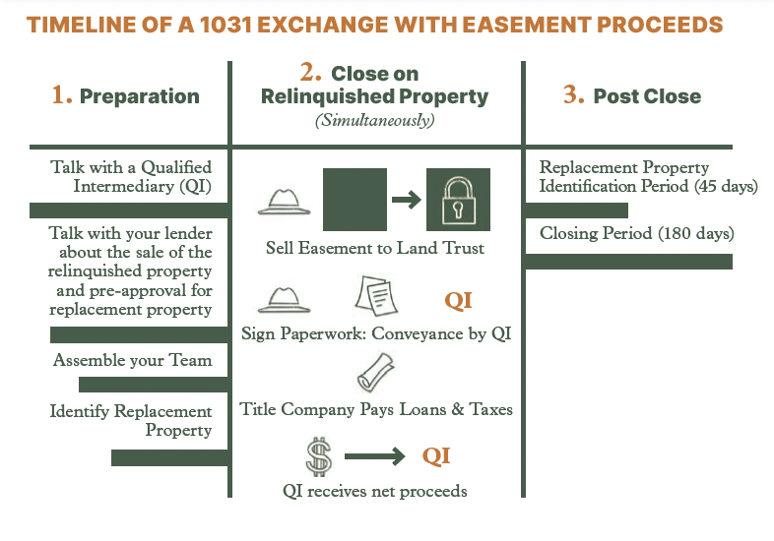
WHY CONVEY AN EASEMENT

Slide 27
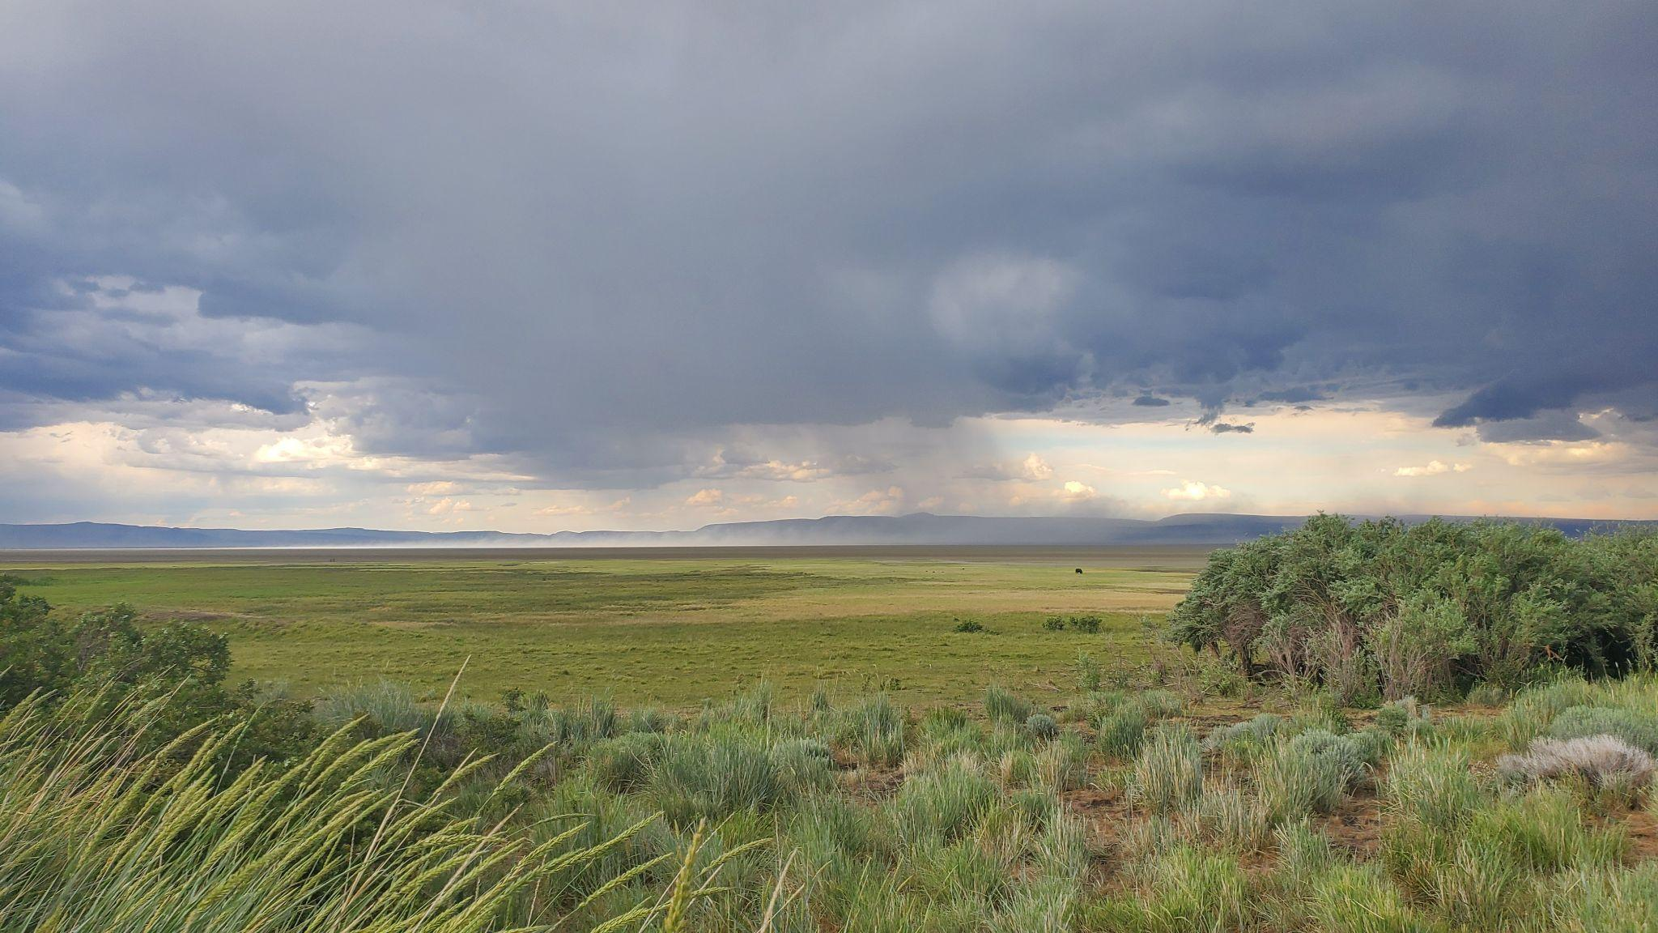
WHY CONVEY AN EASEMENT
Donation
Estate Tax
Gift Tax - reduces property value, speeding up gift timeline
Property Tax - Unaffected if under Farm & Forest Tax Deferral
Income Tax - § 170(h)
Carry forward 15 years
Up to 100% of AGI / year for “qualified farmer or rancher”
Otherwise 50% AGI/year

Slide 28
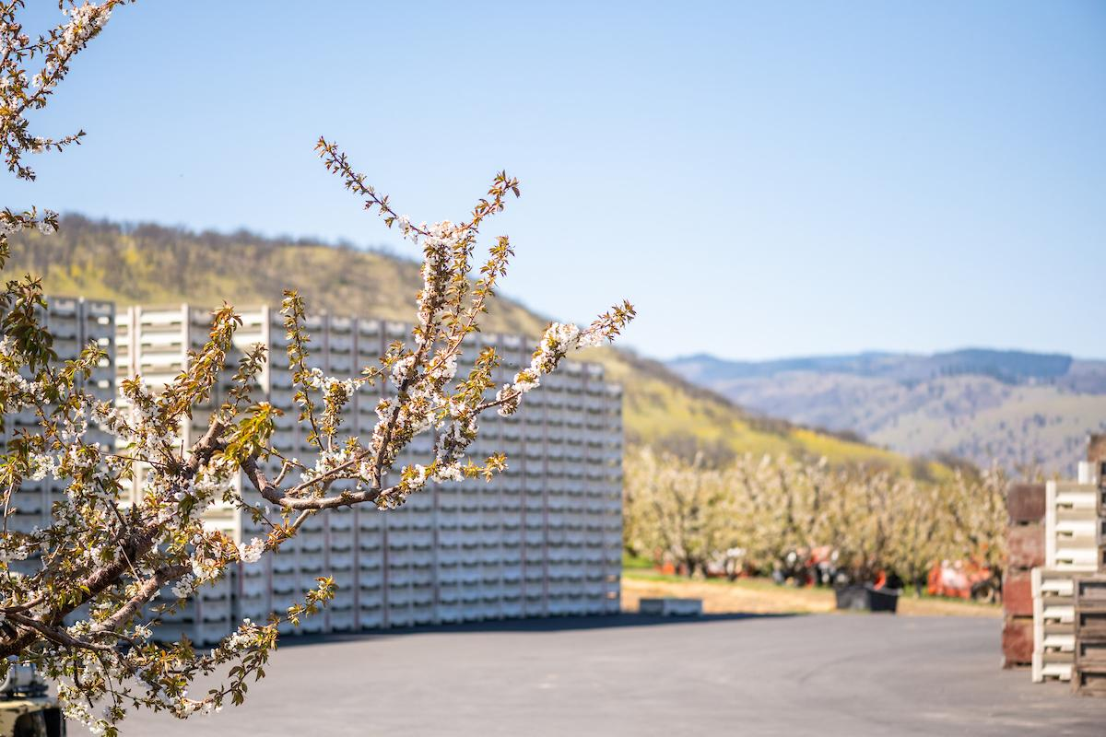
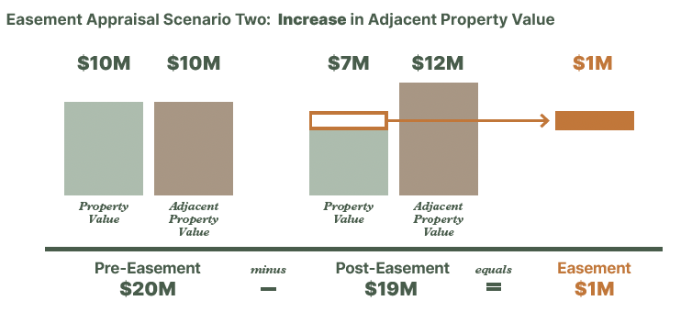
WHY CONVEY AN EASEMENT
Donation
Areas for IRS Scrutiny
Abusive Donations - low before-value, high after-value
Personal Benefit - net increased value including adjacent properties

Slide 29
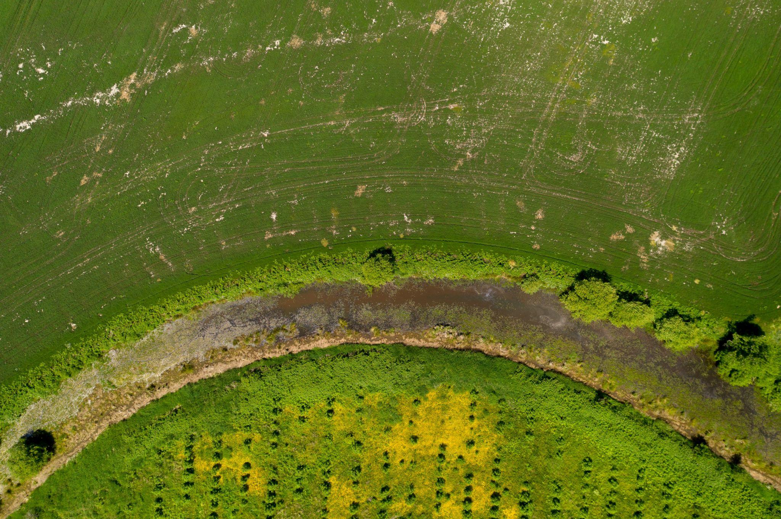
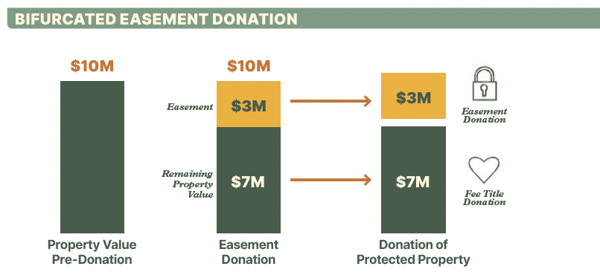
WHY CONVEY AN EASEMENT

Slide 30
HOW TO CONVEY AN EASEMENT
Notes:
Attorney, CPA, financial advisor, family counselor

Slide 31
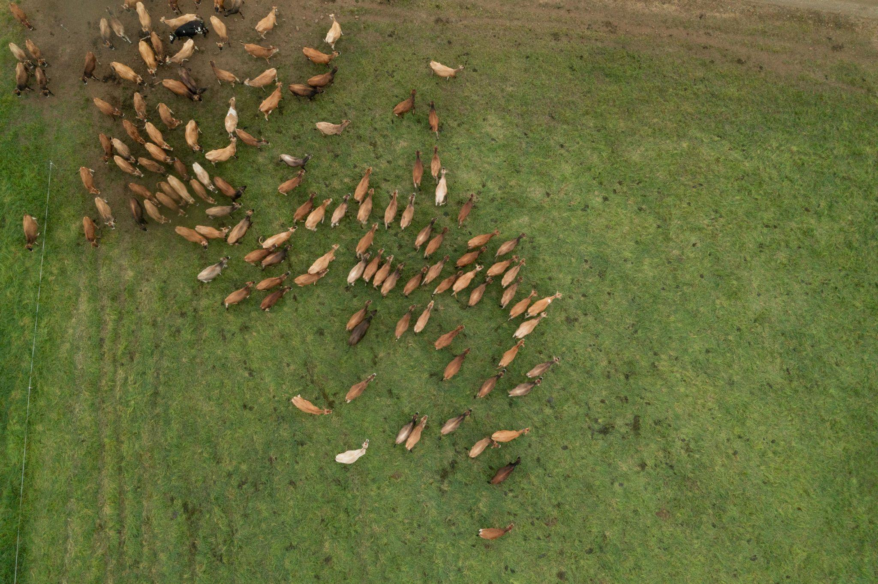
CONVEYING AN EASEMENT
Steps to Granting an Easement
Choose an easement holder
Hire an experienced attorney and accountant
Negotiate terms
Easement holder applies for funding (if landowner wants)
Easement holder does due diligence
Title search
Appraisal
Possible survey
Baseline report
Close on the easement
Notes:
Every easement is written specifically for each property. In partnership with the landowner, the land trust will compile a baseline inventory.

Slide 32
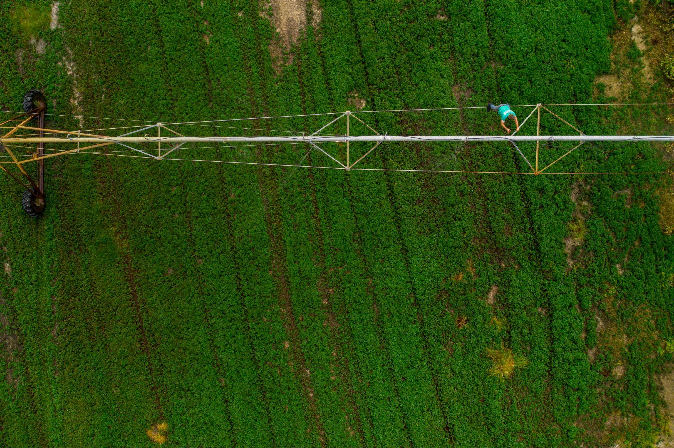
CONVEYING AN EASEMENT
What Happens Afterwards?
Annual monitoring by land trust
Landowner owns the property
Landowner continues day-to-day management
Enforcement, if needed
Paid for by Stewardship Endowment
Notes:
Once the easement is in place, the land trust works with the landowner to ensure that the easement continues to protect the conservation values. Most land trusts visit the property annually, but do not get involved in day to day land management activities. If the terms of the easement are violated and conservation values are threatened or damaged, the land trust must take action to enforce the easement.

Slide 33
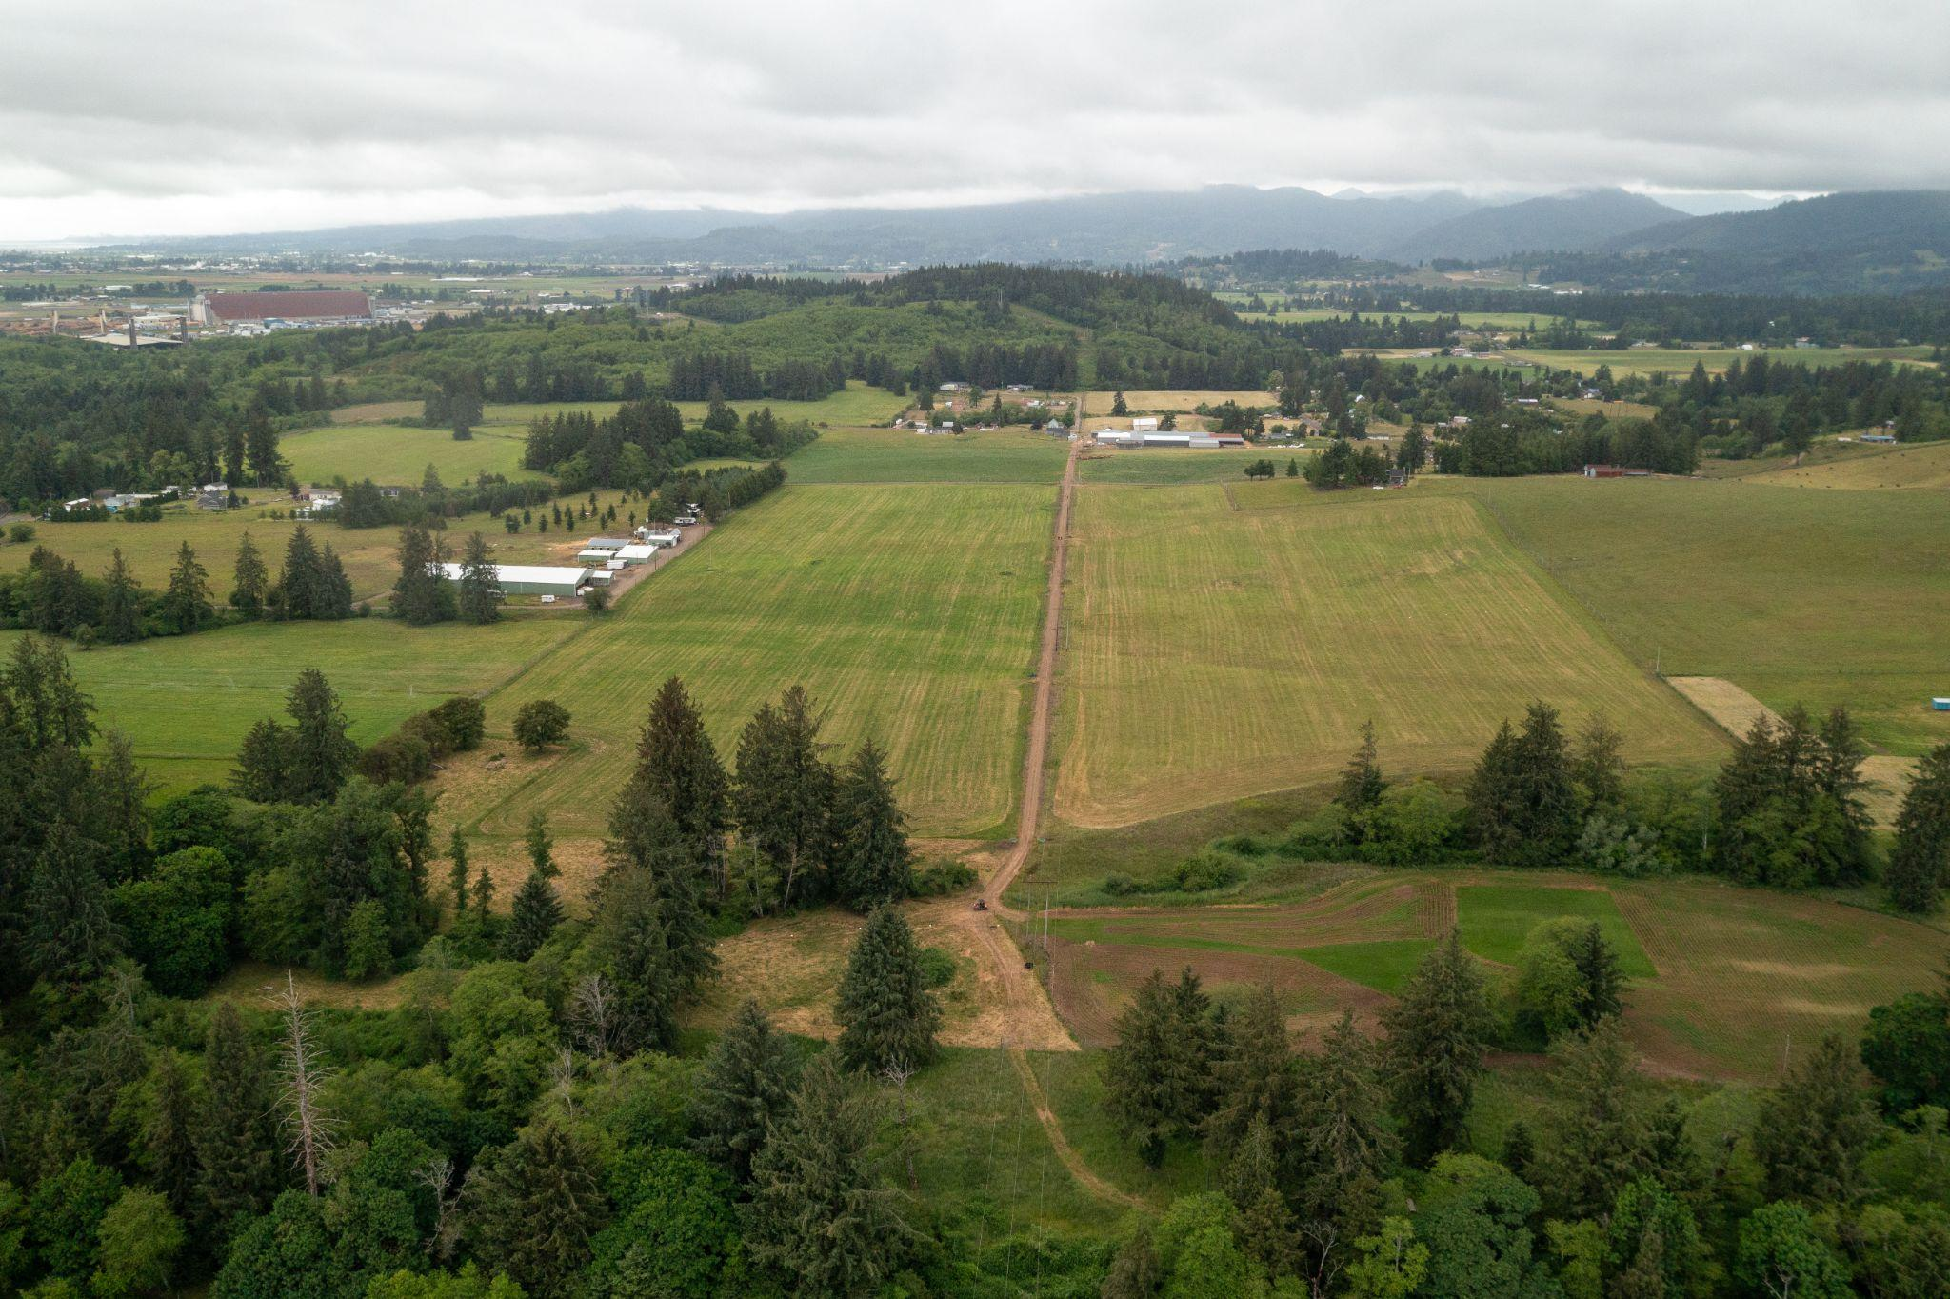
2025-2027 State Legislative Ask
2:1 Federal match for easements

Slide 34
hello@oregonagtrust.org | 503.858.2683 | PO Box 7359, Salem, OR 97303

