Slide 1
Oregon’s Natural Resource Credit and the New Natural Resource Exemption
PRESENTED BY June Wiyrick Flores
Experience what we know about your industry and what it’s like to be represented by Schwabe.
December 7, 2023

Slide 2
Definition of Estate Planning
I want to retain control of my property
I want to give what I have, to whom I want, in the way that I want
I want to protect my assets, and I want to save as much as possible for my family from taxes, creditors, and predators
All without unnecessary costs or delays

Slide 3
NR SUCCESSION PLANNING
Involves creating a plan for your business to successfully transition it as part of your estate plan
The business documents need to dovetail with the estate planning documents so that they fly in formation

Slide 4
GETTING ORGANIZED
In order to create a succession plan, advisors need to have a clear understanding of the client’s business and estate assets and liabilities.
Client should gather all information about the farm operation and its assets including the manner in which the assets are used in farming and fair market values.
This asset information is used to estimate the taxable estate at death.

Slide 5
Federal Estate/Gift Taxes
Federal Estate/Gift Tax is a moving target
2023: $12.92 Million per person (spouses unlimited)/ 40% tax on amount exceeding $12.92 Million
2024: $13.61 Million per person
Difficult to predict changing federal estate/gift tax laws
KEY: Flexible tax planning to capture best tax result for both income taxes and estate taxes

Slide 6
ESTATE TAXES ARE STILL IMPORTANT
Oregon Estate Taxes apply to estates exceeding $1 Million in 2023 at a tax rate of 10% - 16%
1 | 2 | 3 | 4
$1,000,000 | $1,500,000 | $0 | 10.00%
$1,500,000 | $2,500,000 | $50,000 | 10.25%
$2,500,000 | $3,500,000 | $152,500 | 10.50%
$3,500,000 | $4,500,000 | $257,500 | 11.00%
$4,500,000 | $5,500,000 | $367,500 | 11.50%
$5,500,000 | $6,500,000 | $482,500 | 12.00%
$6,500,000 | $7,500,000 | $602,500 | 13.00%
$7,500,000 | $8,500,000 | $732,500 | 14.00%
$8,500,000 | $9,500,000 | $872,500 | 15.00%
$9,500,000 |  | $1,022,500 | 16.00%
If the Oregon taxable estate is at least the amount in column 1, but less than the amount in column 2, the tax is the amount in column 3, increased by the excess above the amount in column 1 multiplied by the percentage in column 4.

Slide 7
Calculating the Oregon Estate Tax
Oregon Residents
Is the decedent’s gross estate valued at $1,000,000 or more? If yes, then an Oregon estate tax return is required. Gross estate includes the fair market value of decedent’s worldwide assets as of DOD.
Determine decedent’s federal taxable estate which is decedent’s worldwide assets less the applicable deductions (debts, expenses, marital deductions, charitable bequests, etc.)
Determine Oregon taxable estate by adjusting the federal taxable estate by adding in Oregon special marital property or Oregon QTIP if decedent is a surviving spouse, deducting property that qualifies for the OSMP or OR QTIP elected in the decedent’s estate, etc.
Calculate the Oregon tax using the chart to determine the tentative tax.
If the decedent owned property outside Oregon, then apportion the tentative tax for any real property or tangible personal property not located in Oregon by applying a fraction to the tentative tax. The numerator is sum of Oregon real property, tangible property in Oregon, and worldwide intangible property. Denominator is the decedent’s gross estate.
Non-Residents own property in Oregon
Same calculation – except the fraction is different. The numerator is the value of the tangible assets (including real estate) located in Oregon and the denominator is gross estate.
Consider converting tangible property to intangible property
Oregon tax is due 12 months from DOD.

Slide 8
Oregon Natural Resource Credit (ORS 118.140)
Provides for a credit for Oregon estate taxes for owners of “natural resource property” (ONR Property) located in Oregon as defined by ORS 118.140(i).
The credit is not available if the decedent’s adjusted gross estate exceeds $15 million.
The credit is limited to the first $7.5 million of ONR Property.
The credit is calculated by applying a ratio to the Oregon estate tax of the value of the ONR Property, up to $7.5 million) to the adjusted gross estate in Oregon.

Slide 9
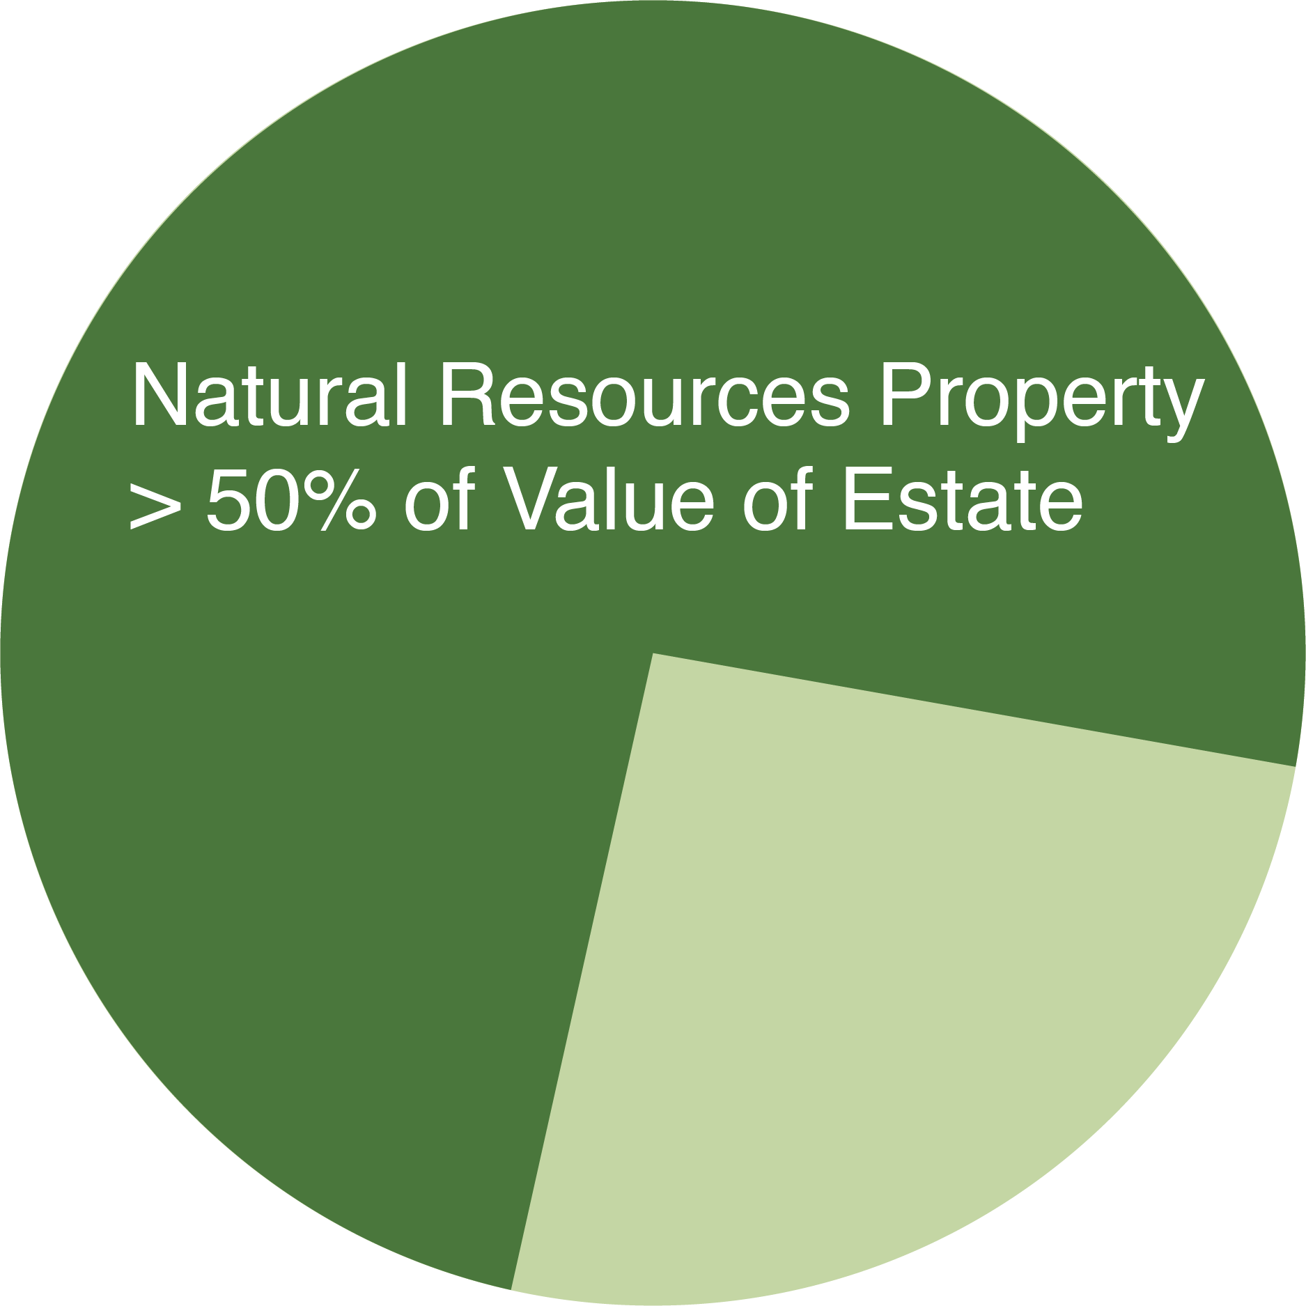
Requirements for the Oregon Natural Resource Credit
Value of the ONR Property exceeds 50% of the adjusted gross estate.
ONR Property must have been owned by the decedent and used in the operation of a farm business, forestry business or fishing business (“FFF Business”) owned by the decedent
For five of the last eight years before death by the decedent or by a member of the decedent’s family.
Inherited by the decedent’s family and continues to be used as ONR Property for five of the eight years after decedent’s death.
The person who inherits must file an annual report with ODR that tracks each asset that was claimed and indicates if it is still in use or has been replaced, or has been disposed of in a manner that is a taxable disposition.

Slide 10
Natural Resource Businesses
Farm Business. “A business operating for the primary purpose of obtaining profit in money by:
Raising, harvesting, or selling fruit or crops;
Feeding, breeding, managing or selling livestock, poultry, fur-bearing animals or bees, or the ‎produce thereof;‎
‎Dairying and selling dairy products;‎
‎Breeding, stabling or training equines;‎
‎Propagating, cultivating, maintaining or harvesting aquatic species, birds or animal ‎species to the extent allowed by the rules adopted by the State Fish and Wildlife Commission;‎
‎Raising nursery stock;‎
‎Practicing animal husbandry; or‎
‎Raising other agricultural or horticultural products.”
Fishing Business. “Fishing in which the fish harvested, either in whole or in part, are intended to enter commerce or enter commerce through sale, barter or trade.” (IRC Section 1301(b)(4) and Section 3 of the Magnuson-Stevens Fishery Conservation and Management Act (16 U.S.C. 1802). ORS Chapter 508:
Owned a vessel used in taking food fish or shellfish for commercial purposes (ORS 506.006);
Held a boat license (ORS 508.260);
Held a commercial fishing license (ORS 508.235); and
Held one or more restricted fisheries permits (ORS 508) or an equivalent restricted vessel permit system under the laws of another state.
Forestry Business. “A business operated for the primary purpose of obtaining a profit in money by the planting, cultivating, caring for, preparing, harvesting or cutting of timber or trees for market.”

Slide 11
What is Natural Resource Property?
Property located in Oregon, if on the date of the decedent’s death, the property was owned by the decedent and used in the operation of a farm business, forestry business or fishing business owned by the decedent.
Real property used as forestland or as forestland homesites, not to exceed 5,000 acres
Real property in farm use.
Timber or trees.
Crops, fruit or other horticultural products, both growing and stored.
Forestry business or farm business equipment.
Livestock, poultry, fur-bearing animals, bees, dairying animals, equines, aquatic species, birds or other animal species, including stored products or by-products.
Nursery stock as defined in ORS 571.005.
Boats, gear, equipment, vessel licenses or permits, commercial fishing licenses or permits and other real or personal property used in the operation of a fishing business.
Real or personal property used to process and sell the catch of a fishing business in fresh, canned or smoked form directly to consumers, including a restaurant with seating capacity of fewer than 15 seats at which catch from the fishing business is prepared and sold.
An operating allowance
Any other tangible and intangible personal property used in the operation of a farm business, forestry business or fishing business.

Slide 12
NRC Requirements/Definitions Cont’d
Residence
May include a residence if it is part of the natural resource property – dwelling on farm or timberland ORS 308A.250
Residence likely qualifies if it qualifies under the property tax rules for EFU, timber, farm deferral, etc.
Someone living in dwelling with connection to farm (i.e. Owner, watching over property, security, etc.)
Operating Account
Limited to amount up to the lesser of $1M or 15% of the total value of the property claimed
Family Member.
Decedent’s ancestors, decedent’s spouse, the lineal descendants and their spouse of decedent, decedent’s spouse, and decedent’s parents. Legally adopted children are treated as child by blood.
Ancestor means a person from whom the decedent is directly descended, such as a parent, grandparent, or great-grandparent. The term does not include aunts, uncles, or cousins. OAR 150-118-0110(1)(b).
Lineal descendant means a person in a direct line of descent from the decedent, such as a child, grandchild or great-grandchild.
Lineal descendant of a parent of the decedent means a decedent’s siblings, children and grandchildren of those siblings, and any other person in a direct line of descent from the decedent’s siblings.
Includes decedent’s sister and her spouse, but does not include the sister of decedent’s spouse.

Slide 13
Indirect Ownership of Natural Resource Property
ONR Property may be held indirectly in partnership, trust or LLC. The family member who inherits must materially participate in the business after the transfer.
Materially participate – means engage in active management per IRC Section 2032A; also see IRS Treas. Reg. § 20.2032A-3.
“Active Management” is defined by Internal Revenue Code (IRC) Section 2032A(e)(12) to mean the making of the management decisions of a business (other than the daily operating decisions). OAR 150-118-0110(1)(a).
Factual determination.
Actual employment on full-time basis (35 hours/week) or to any lesser extent necessary personally to manage fully the business.
More than passively collecting rents. All necessary functions are preformed even though little or no activity may occur during nonproducing seasons.
If self-employed by business, are they paying self-employment taxes?
Look at each participant’s activities separately – only 1 must be material.
Physical work, participation in management decisions – substantial number of decisions; regularly inspecting production activities
Examples of active management decisions: “inspecting growing crops, animals, forests, or equipment; reviewing and approving annual crop plans in advance of planting; making a substantial number of the management decisions of the business operation; approving expenditures for other than nominal operating expenses in advance of the time the amounts are expended; deciding what crops to plant or how many cattle to raise; determining what fields to leave fallow; determining where and when to market crops and other business products; determining how to finance business operations; and determining what capital expenditures the trade or business should make.” OAR 150-118-0110(3)(f).

Slide 14
What happens if the owners sell or stop using a claimed assets as ONR Property?
Can sell and replace personal property with other ONR Property, must continue to use as ONR Property in FFF Business.
Can sell the property to a qualified family member and not recapture tax.
If sell or dispose of, then subject to a “recapture tax” which is the estate tax pro rated over the 5 year period after death at 20% per year. Family member must keep as ONR property for 5 out of 8 years post death.
Ex. If sell property in Year 3, then recapture 40% of tax
If the cash or other ONR Property is used to pay federal or state estate taxes, that is treated as a disposition and requires payment of the estate tax.
Tax is due within 6 months of disposition of ONR Property
Recapture of tax also applies if do not sell but cease to use it as ONR Property.

Slide 15
NEW - Oregon Natural Resource Exemption
SB 498, OR Laws 2023, Ch. 286 to be added to ORS Chapter 118
Exempts natural resource property from the Oregon estate tax.
Limited to $15 million.
Applies to estates of decedents who passed after July 1, 2023
Estate may choose the NRC or the Exemption – cannot utilize both.

Slide 16
Requirements for Natural Resource Exemption
Decedent owned property for 5 years prior to death
Decedent or decedent’s family member materially participated in an FFF Business during at least 75% of days of each of 5 calendar years immediately prior to decedent’s death.
Interest is transferred as consequence of decedent’s death to one or more of decedent’s family members and is subsequently owned by the decedent’s family members for at least 5 consecutive calendars years beginning with calendar year immediately following decedent’s date of death
If died in 2023, then 5 years begins January 1, 2024
Any family member of decedent materially participated in FFF Business at least 75% of days of each of 5 calendar years immediately following decedent’s date of death

Slide 17
Natural Resource Exemption
Definitions
Family member: “a person within the third degree of relation, by blood, marriage, adoption, civil union or domestic partnership to another person.”
Great-grandparent, grandparent, parent, uncle, aunt, nieces, nephews, great-aunt, great-uncle – spouses and children of such persons.
Materially participate: active management as defined by IRC Section 2032A of FFF Business.
Natural Resource Property: same definition as used for the Natural Resource Credit.
Additional Tax Imposed – estate tax that would have been imposed if the transferred ONR Property had been included in decedent’s estate if during the 5 year period after decedent’s death:
the ONR Property is sold or otherwise transferred to a person other than a family member of the decedent
the material participation requirement is not met, then the transferees must pay the estate tax that would have been paid if the exemption had not applied.

Slide 18
Differences Between Credit and Exemption
Credit | Exemption
Value of the ONR Property exceeds 50% of the adjusted gross estate | No requirement for adjusted gross estate
Credit limited to $7.5MM of ONR Property | Exemption limited to $15MM of ONR Property
Operating Allowance – limited to lesser of up to $1 million or 15% of total value of ONR Property claimed | Operating Allowance – no direct limit
ONR Property must have operated as a natural resource business for five of the last eight years before death by the decedent or by a member of the decedent’s family | Decedent owned property for 5 years prior to death Decedent or decedent’s family member materially participated in FFF Business during at least 75% of days of each of 5 calendar years immediately prior to decedent’s death

Slide 19
Credit | Exemption
Inherited by the decedent’s family and continues to be used as ONR Property for five of the eight years after decedent’s death. | Interest is transferred as consequence of decedent’s death to one or more of decedent’s family members Continues to be owned for 5 consecutive calendars years beginning with calendar year immediately following decedent’s date of death by family member Any family member of decedent materially participated in FFF Business at least 75% of days of each of 5 calendar years immediately following decedent’s date of death
Family Member: decedent’s ancestors, decedent’s spouse, the lineal descendants and their spouse of decedent, decedent’s spouse, and decedent’s parents. Legally adopted children are treated as child by blood. | Family Member: a person within the third degree of relation, by blood, marriage, adoption, civil union or domestic partnership to another person.
Material Participation – only required for indirect ownership | Material Participation – required for 5 years before and after death
Annual filing after death to track assets. | No regulations yet that require annual filing
Tax – if disposed of after death, then tax is pro-rated at 20% per year. | Tax – no proration if disposed of within 5 years after death

Slide 20
Forest Conseration Tax Credit
Tax credit to small forest landowners who agree to follow timber harvest restrictions – estate or income tax credit.
Requirements:
Landowner owns less than 5,000 acres of Oregon forestland
Harvested no more than an average of 2MM board feet of timber each year during past 3 years; and
Does not expect to harvest more than an average of 2MM board feet of timber during next 10 years.
Operation of timber harvest Type 1, 2, or 3 next to an eligible stream that has specific vegetation retention requirements and harvest area that is at least same size as the area that will not be harvested.
Record deed that includes irrevocable restriction prohibiting harvest in the forest conservation area during 50 years.
ODF certifies the amount of the tax credit.
Credit based on value of unharvested timber, cost of appraisal, and recording fee.
The amount used on the estate tax return cannot exceed the tax liability.
The unused credit can carry forward to the decedent owner’s heirs.
If the timber is harvested prior to the 50 year restriction, then the credit must be repaid.
Applicable to decedent’s who died on or after 1/1/2023

Slide 21
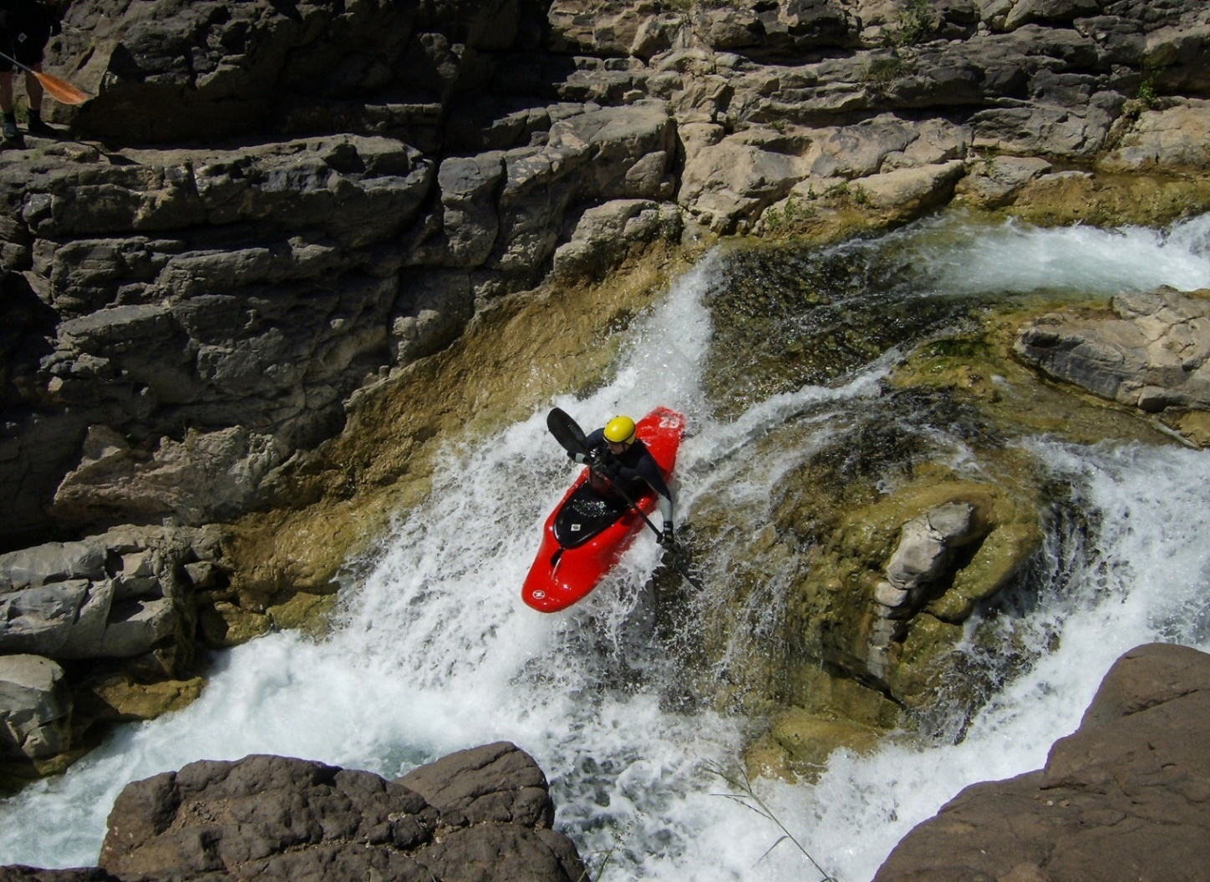
GIFTING VS. INHERITANCE
ESTATE TAX
INCOME TAX

Slide 22
Income Tax

Slide 23
Gifting
Oregon residents can reduce their taxable estates by making gifts during life
Example: Mary dies with assets of $2.5 million – estate owes $152,000 OET. If Mary gave away $1.5 million, then zero estate tax.
When in doubt, file the 709
File Gift Tax Return to establish value and start statute of limitations running
Use certified appraisals
Especially important if discounting minority interests
Make sure gift is “complete” so cannot be pulled back into the estate
Don’t forget about GSTT on gift if applicable
Notes:
Common entity structure includes:
Land holding LLCs
Operating LLC (may also be run as S Corp)
Leases between the Land holding LLCs that may include right of first refusal to purchase
Operating Agreements should include clear instructions on transfer of membership interest.
Frequently create “last man standing” LLCs in which one family buys out other family members, sometimes at discounted values.
Make sure trust plan is hooked up to business plan and operating agreements provide for transfer to trust.

Slide 24
Planning Considerations/Issues
How to attain 75% of days of 5 years
Forestry – cameras to check on trees
Fishing – cameras to look at boats, equipment
Exemption is up to $15MM vs. federal lifetime exemption – using bypass or QTIP trusts.
Gifting assets other than ONR Property to reduce estate to meet credit 50% rule
Waiting for 2024 legislative session to see if any clarifications to exemption statute to confirm:
Exemption available if ONR Property is owned indirectly
Post-death transfers to LLCs or trusts allowed
5 calendar years vs. 60 months from DOD
Destruction of crops is not a disposition event

Slide 25
June Wiyrick Flores
Shareholder
I strive to make a meaningful impact on people’s lives by working with families, family businesses, and closely held businesses to develop and implement highly customized estate plans and succession strategies.
My area of practice also encompasses business clients with formation needs, development of governance structures, reorganizations and dissolutions, and mergers and acquisitions; extending to charitable and nonprofit organizations. I’m experienced in counseling tax-exempt and philanthropic organizations with formation and operations matters.
503-796-2477
jwflores@schwabe.com

Slide 26
INDIAN COUNTRY AND ALASKA NATIVE CORPORATIONS
HEALTHCARE AND LIFE SCIENCES
REAL ESTATE AND CONSTRUCTION
COMMERCIAL PRODUCTS, MANUFACTURING, AND RETAIL
NATURAL RESOURCES
TECHNOLOGY
PORTS AND MARITIME

