Slide 1
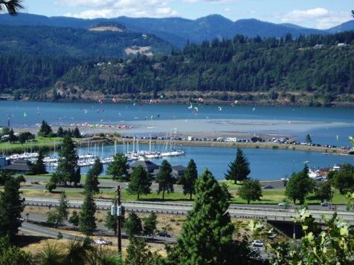
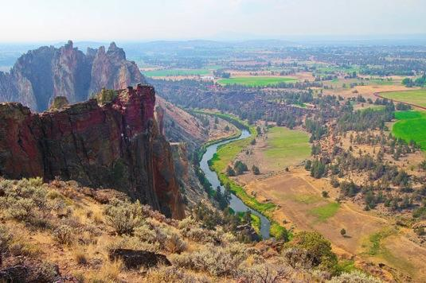
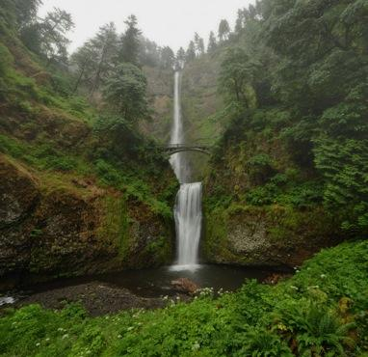
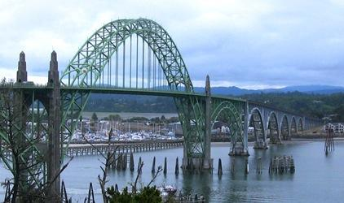
Agricultural Law Section- 2023 Agricultural Law Round Up CLE December 7, 2023 Land Use Updates from 2023 Legislative Session Mary Kyle McCurdy, Deputy Director, 1000 Friends of Oregon

Slide 2
2023 Bills - Land Use & Agricultural Lands
HB 3409 - Rural Climate Issues
Siting of Large Scale Solar Facilities
Natural & Working Lands
Community Green Infrastructure Grant Program and Green Communities Nurseries
HB 3630 - State Energy Strategy
SB 5506 - Omnibus Funding Bill
SB 4 - Semiconductor Siting
HB 3414B - Housing & UGBs
Notes:
This evening we are going to focus on one example of how ideas can become a proposed bill; what it takes to get a land use bill passed so it becomes a law (statute); how that law directs LCDC to adopt administrative rules to both guide and direct cities and counties in revising their local plans & codes to conform to the new law; how the agency (DLCD) goes about crafting a proposing a set of admirative rules to LCDC; how those rules are implemented at the local level. And how public engagement and coalitions are critical at every stage.

Slide 3
HB 3409 – Rural Climate Policy
Siting of Large-Scale Solar Facilities (sections 35-37)
Directs LCDC to adopt administrative rules by July 1, 2025 which:
identify low-conflict areas
in eastern Oregon: “that portion of the State of Oregon lying east of a line beginning at the intersection of the northern boundary of the state and the western boundary of Wasco County, thence southerly along the western boundaries of the counties of Wasco, Jefferson, Deschutes and Klamath to the southern boundary of the state.
for the siting of large-scale solar facilities
Rules must:
Consider potential conflicts with other resource lands
Identify the Eastern Oregon characteristics of lands that are best suited for solar power generation facilities, taking into account:
The land’s suitability for contributing to the state’s clean energy goals
Site characteristics, resource potential, proximity to current and future transmission access and locations for potential interconnection
The ability to readily avoid negative impacts on natural resources, forestry, habitat, agriculture, community needs and historic, cultural or archeological resources, or to readily minimize or mitigate those negative impacts.
Notes:
This evening we are going to focus on one example of how ideas can become a proposed bill; what it takes to get a land use bill passed so it becomes a law (statute); how that law directs LCDC to adopt administrative rules to both guide and direct cities and counties in revising their local plans & codes to conform to the new law; how the agency (DLCD) goes about crafting a proposing a set of admirative rules to LCDC; how those rules are implemented at the local level. And how public engagement and coalitions are critical at every stage.

Slide 4
HB 3409 – Rural Climate Policy
Natural & Working Lands (sections 53-67)
Establishes a state policy for Natural Climate Solutions and the Natural and Working Lands Fund
The Natural Climate Solutions Program will be administered by the Oregon Climate Action Commission, via the Oregon Watershed Enhancement Board (OWEB) to:
provide financial incentives and technical support
to farmers, ranchers, and other land managers
to voluntarily continue or adopt climate-friendly solutions, including soil-health practices, for such things as carbon sequestration.
And it will secure and leverage federal and private investments in natural climate solutions on natural and working lands
Notes:
This evening we are going to focus on one example of how ideas can become a proposed bill; what it takes to get a land use bill passed so it becomes a law (statute); how that law directs LCDC to adopt administrative rules to both guide and direct cities and counties in revising their local plans & codes to conform to the new law; how the agency (DLCD) goes about crafting a proposing a set of admirative rules to LCDC; how those rules are implemented at the local level. And how public engagement and coalitions are critical at every stage.

Slide 5
HB 3409 – Rural Climate Policy
Community Green Infrastructure Grant Program & Green Communities Nurseries (Section 27)
Establishes the community green infrastructure grant program to fund green infrastructure, such as urban forestry, green stormwater-management systems, supporting native seed banks and native plant nurseries, replanting after wildfires, and more.
Establishes Green Communities Nurseries Program within the Oregon Dept of Agriculture. It will certify nurseries that:
Satisfy certain pest & disease management practices
Demonstrate compliance with federal, state & local rules regarding worker compensation, health & safety
Grow and maintain noninvasive nursery stock to use in green infrastructure projects.
Notes:
This evening we are going to focus on one example of how ideas can become a proposed bill; what it takes to get a land use bill passed so it becomes a law (statute); how that law directs LCDC to adopt administrative rules to both guide and direct cities and counties in revising their local plans & codes to conform to the new law; how the agency (DLCD) goes about crafting a proposing a set of admirative rules to LCDC; how those rules are implemented at the local level. And how public engagement and coalitions are critical at every stage.

Slide 6
SB 3630 – State Energy Policy
Directs ODOE to develop a comprehensive state energy strategy that “identif[ies] optimized pathways to achieving the state’s energy policy objectives.”
ODOE must must look at: energy demand and trends; energy resources and technology; costs & energy efficiency; economic impacts; energy resilience & reliability; environmental justice; land use; natural resource impacts; energy generation, transmission and distribution infrastructure needed to achieve state energy policy objectives.
Notes:
This evening we are going to focus on one example of how ideas can become a proposed bill; what it takes to get a land use bill passed so it becomes a law (statute); how that law directs LCDC to adopt administrative rules to both guide and direct cities and counties in revising their local plans & codes to conform to the new law; how the agency (DLCD) goes about crafting a proposing a set of admirative rules to LCDC; how those rules are implemented at the local level. And how public engagement and coalitions are critical at every stage.

Slide 7
SB 5506 – Omnibus Funding Bill
The Morrow and Umatilla Drought Relief Aquifer Recharge and Aquifer Storage and Recovery Project
OSU Extension Service’s Center for Small Farms and Community Food Systems
The Oregon Community Food Systems Network to develop regional food-system infrastructure and support small-scale farms and ranches
Oregon Farm to School grant program, supporting education, school food programs, and food producers across the state
Notes:
This evening we are going to focus on one example of how ideas can become a proposed bill; what it takes to get a land use bill passed so it becomes a law (statute); how that law directs LCDC to adopt administrative rules to both guide and direct cities and counties in revising their local plans & codes to conform to the new law; how the agency (DLCD) goes about crafting a proposing a set of admirative rules to LCDC; how those rules are implemented at the local level. And how public engagement and coalitions are critical at every stage.

Slide 8
Senate Bill 4 – Semiconductor Siting & Funding
Provides Governor a limited ability to site a high-tech facility on farmland if certain conditions are met
Expires December 2024
Legislature provided $240 million for companies who successfully qualified for federal CHIPS Act funding
To date, Governor has approved the $240 million to 15 Oregon semiconductor facilities under tentative plans. None needs additional land.
Notes:
This evening we are going to focus on one example of how ideas can become a proposed bill; what it takes to get a land use bill passed so it becomes a law (statute); how that law directs LCDC to adopt administrative rules to both guide and direct cities and counties in revising their local plans & codes to conform to the new law; how the agency (DLCD) goes about crafting a proposing a set of admirative rules to LCDC; how those rules are implemented at the local level. And how public engagement and coalitions are critical at every stage.

Slide 9
HB 3414B – UGBs & Farm Land
Would allow expansion of urban growth boundaries without application of Oregon land use laws, including Goals 10, 14, and several statutes and administrative rules
75 or 150 acres, depending on population of city
Without a showing of need for land to meet housing needs
Notes:
This evening we are going to focus on one example of how ideas can become a proposed bill; what it takes to get a land use bill passed so it becomes a law (statute); how that law directs LCDC to adopt administrative rules to both guide and direct cities and counties in revising their local plans & codes to conform to the new law; how the agency (DLCD) goes about crafting a proposing a set of admirative rules to LCDC; how those rules are implemented at the local level. And how public engagement and coalitions are critical at every stage.

